Slide 1
Chapter 10： Virtual Memory

Slide 2
Outline
Background
Demand Paging
Copy-on-Write
Page Replacement
Page Replacement Algorithm
Page buffering Algorithm
Allocation of Frames
Thrashing
Memory Compression
Allocating Kernel Memory
Other Considerations

Slide 3
Motivation
Memory Management in Chapter 9
A process needs to be entirely loaded into the memory
Q: but, in many cases, entire program is not needed. Why?
Code to handle unusual error conditions
Arrays, list, and tables are often allocated more than they need
Certain options/features may be used rarely (Ex: Word, PowerPoint…)
Even when the entire program is needed, it may not all be needed at the same time (see the following slide)

Slide 4
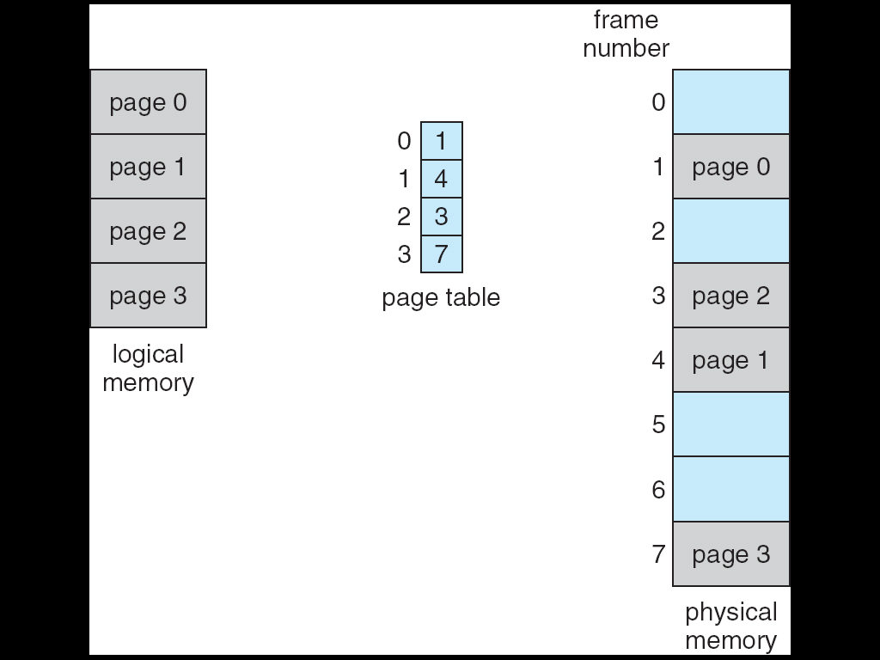
Paging Model of Logical and Physical Memory

Slide 5
Q: So, 如何利用這個特色呢?
Hint: execute partially-loaded program

Slide 6
Virtual Memory
Idea: Execute partially-loaded program
Solution: Virtual memory
Only part of the program is in memory for execution

Slide 7
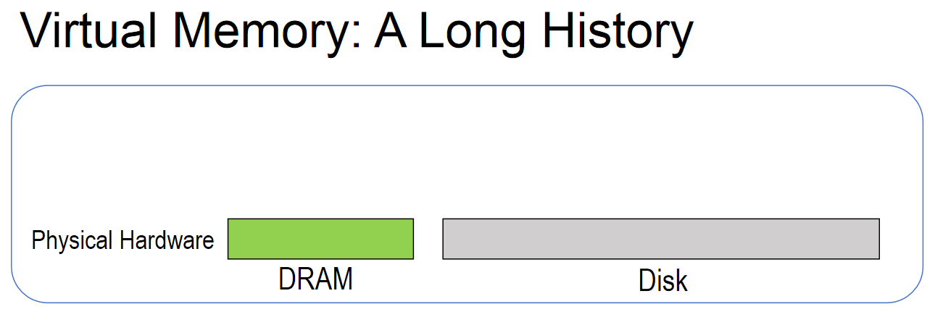
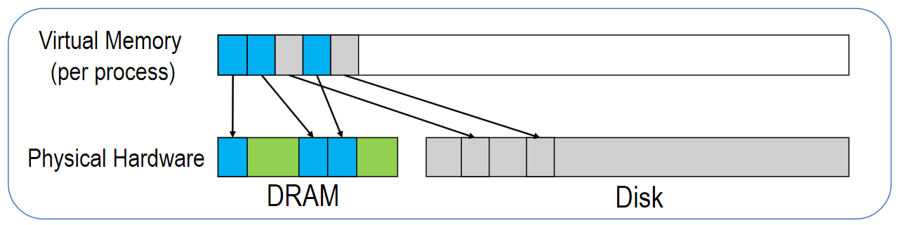
Virtual Memory
https://www.usenix.org/sites/default/files/conference/protected-files/atc16_slides_huang.pdf

Slide 8
Q: 虛擬記憶體有什麼好處呢?

Slide 9
Benefits
Benefits
Program no longer constrained by sizes of physical memory
Less memory is needed for each process
In previous slide, only 3 pages (instead of 5) are kept in memory
More processes in memory
Less I/O needed and faster response
Less I/O needed to load programs into memory

Slide 10
Q: But, how to implement virtual memory?

Slide 11
Outline
Background
Demand Paging
Basic Concepts
Performance of Demand Paging
Copy-on-Write
Page Replacement
Page Replacement Algorithm
Page buffering Algorithm
Allocation of Frames
Thrashing
Memory Compression
Allocating Kernel Memory
Other Considerations

Slide 12
Demand Paging
Virtual memory can be implemented via demand paging
A great benefit of paging scheme
Paging的優點
Eliminate external fragmentation
Facilitate memory sharing
Support virtual memory

Slide 13
Q: what is demand Paging?
Ans: bring a page from disk into memory only when it is needed

Slide 14
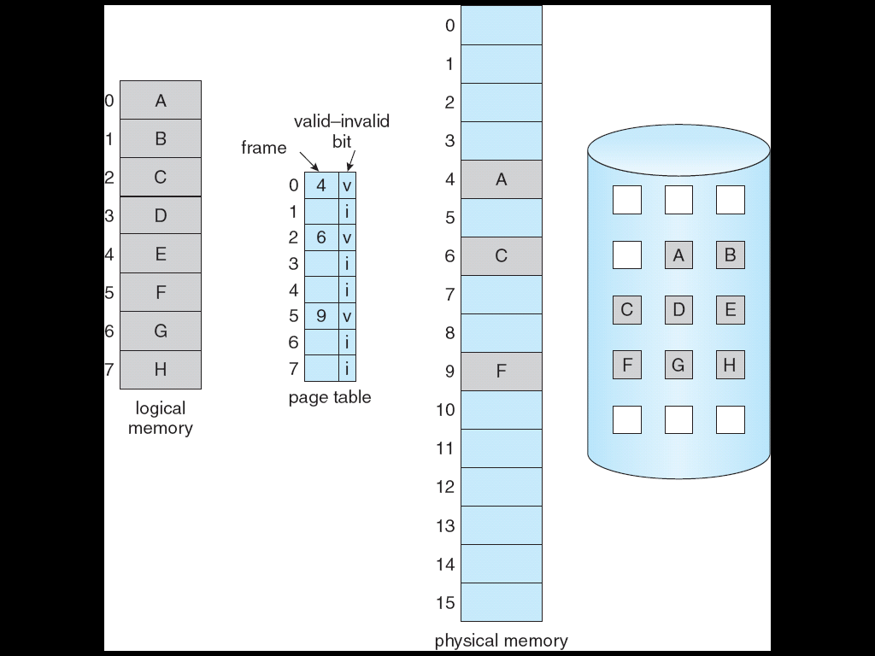
Demand Paging: Physical Memory is Not Full
Page not in physical memory
B
page in

Slide 15
Swapper vs. Pager
Comparison
Swapper: manipulate entire processes
Seldom used today
Pager (or Lazy Swapper): manipulate the individual pages of a process
Bring in a page only when the page is needed

Slide 16
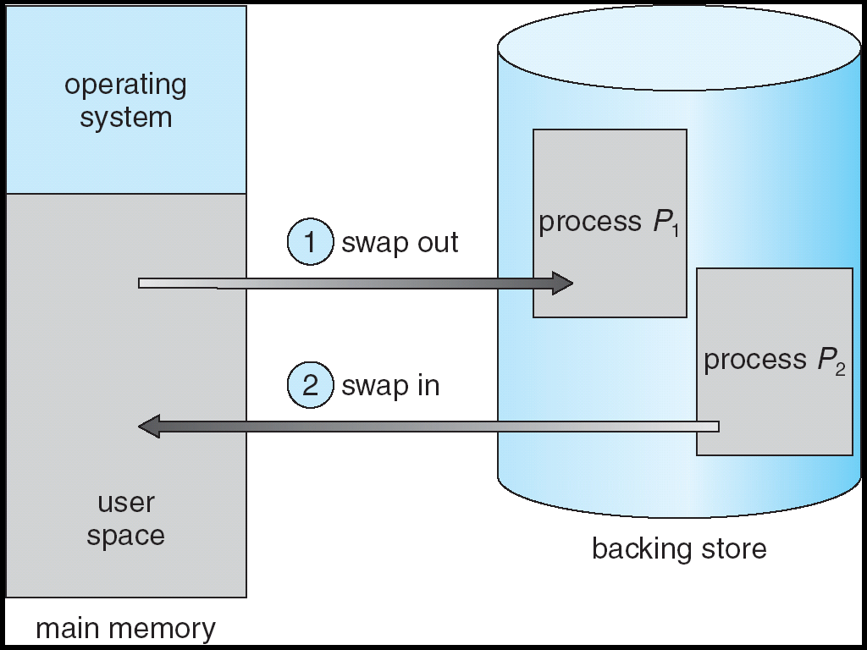
複習: Schematic View of Swapping

Slide 17
所以, exec()不再將整個執行檔載入到記憶體
See the following slide.
事實上, exec()只是讀取執行檔的檔頭, 只有當程式之後執行時用到某個page才會將該page載入

Slide 18
複習: The exec() System Call
Memory
Copy from original image
Original image
fork()
Load another image
New image
exec()
NCHU System & Network Lab

Slide 19
Q: 那fork()呢?
Shown later~

Slide 20
Q: if physical memory is full, we must select a victim for page out. Where to put the pages that are paged out ?
Ans: see the following two slides

Slide 21
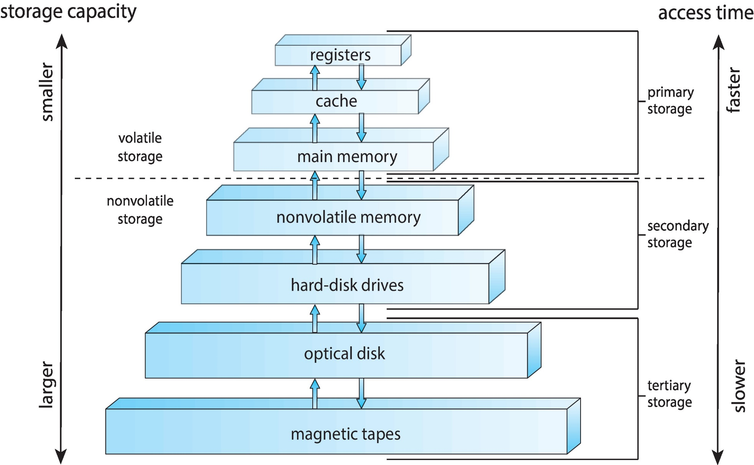
複習: Storage-Device Hierarchy

Slide 22
Page In and Page Out
Page not in physical memory
page in
I
I
B
page out

Slide 23
Swap Space
Where to put the pages that are paged out ?
Secondary memory: hold the pages not in main memory
Specifically, a partition on the secondary memory
Called Swap space or backing store

Slide 24
Q: if memory is not full, where to put the pages that are paged in ?
Ans: free-frame list

Slide 25
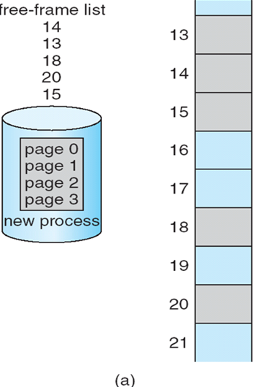
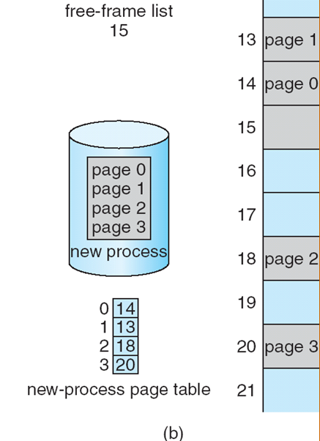
複習：Free-Frame List in Chapter 9
Before allocation
After allocation

Slide 26


Free-Frame List in Chapter 10: 假設程式存取page 0
Before allocation
After allocation

Slide 27
Q: 在demand paging, 何時會使用free-frame list?
Ans:
Upon the accessed page is not in memory, called a page faults
Upon stack or heap expand (see the following slide)

Slide 28
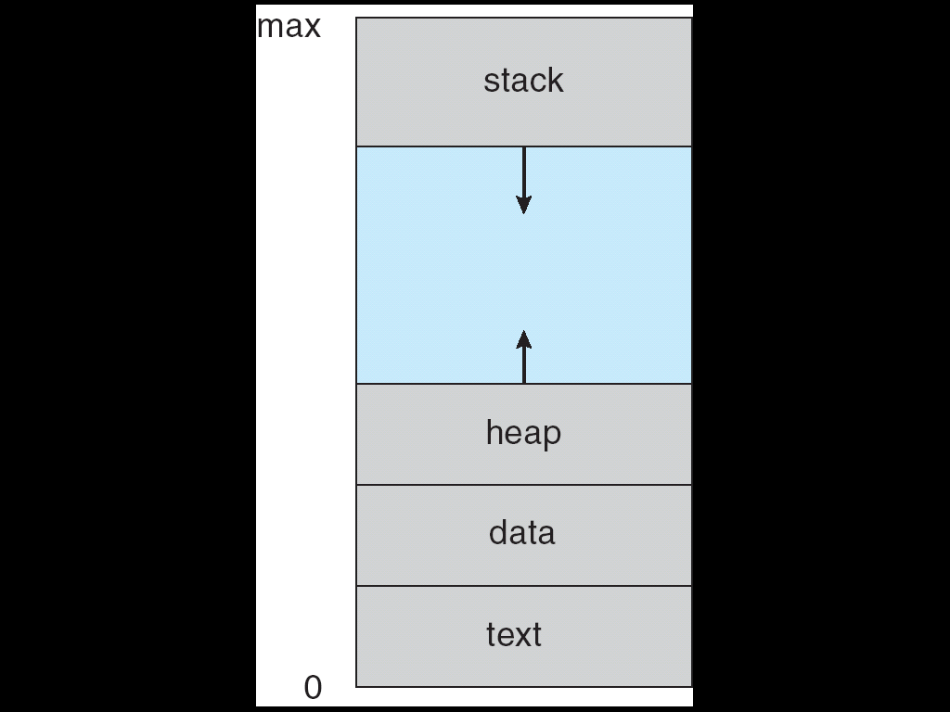
複習：Process
Virtual memory

Slide 29
Virtual Address Space of a Process
Sparse (空閒的) address spaces:
Virtual address spaces that include holes
See the following slide
The hole between heap and stack is also part of the virtual address space
No physical memory needed until heap or stack grows
See the following next slide

Slide 30
複習：Process
Virtual memory

Slide 31
複習: Stack
main()
{
.
.
a = a + 1;
function_1(…);
exit(1);
}
function_1()
{
b = b - 1;
function_2(…);
return;
}
function_2()
{
…
return;
}
stack
ESP
arugment
return address
local variables
ESP
argument
return address
local variables
ESP
argument
return address
local variables

Slide 32
Free-frame lists are zero-fill-on-demand (Zero-out before being allocated). Why?

Slide 33
Q: 當程式執行時, 我們必須知道存取的page是否有在記憶體當中. 誰負責偵測這件事情?
Hint: hardware or OS

Slide 34
複習：Demand Paging: Physical Memory is Not Full
Page not in physical memory＝>如何知道?
B
page in

Slide 35
Hardware Support for Demand Paging
Upon execution, how do we know if a page is in memory or not?
Need hardware support.
Q: Why not software?

Slide 36
複習: OS不知道發生記憶體存取
…
mov eax, 10
mov temp, eax
…
CPU
…..
eax | 10
OS

Slide 37
Q: 當程式執行時, 我們必須知道存取的page是否有在記憶體當中. 如何偵測?

Slide 38
Hardware Support for Demand Paging
Q: how do we know if a page is in memory or not?
Ans: valid-Invalid bit in the page table
We saw it in Chapter 9
Now, valid-invalid bit is re-defined for virtual memory management
With each page table entry, a valid–invalid bit is associated
1➔ legal and in-memory;
0 ➔not-in-memory or illegal

Slide 39

複習： Valid (v) or Invalid (i) Bit in a Page Table for Memory Protection
If virtual address space = 8 pages, each page table entry associate with valid/invalid bit.
0 | 1 | v
1 | 4 | v
2 | 3 | v
3 | 7 | v
4 | 0 | i
5 | 0 | i
6 | 0 | i
7 | 0 | i

Slide 40
Page Table When Some Pages Are Not in Main Memory
In-valid
B
Valid : addr translation
Invalid: trap

Slide 41
Q: 當invalid時, CPU怎麼辦呢?
Ans: 跳到OS, 請OS處理page fault

Slide 42
複習: Event-Driven OS
OS is event-driven
Events
Interrupt: driven by hardware
Trap (or exception): a software-generated interrupt
Error: Division by zero, illegal instructions, page fault trap
System calls: functions provided by OS to provide service to applications
Ex: read(), write(), open()……

Slide 43
Page Table When Some Pages Are Not in Main Memory
In-valid
B
Valid : addr translation
Invalid: trap

Slide 44
Page Table When Some Pages Are Not in Main Memory
11
v
B
Valid : addr translation
Invalid: trap

Slide 45
Q: Who sets the valid-invalid bit?
Ans: OS (see the following slide)

Slide 46
接下來看page fault的處理流程~

Slide 47
Page Fault Handling
During address translation by MMU, if valid–invalid bit is 0 ➔ page-fault trap
CPU jump to the OS
OS then handle the trap
Page in the desired page
Get a free frame from the free-frame list and read desired page into the allocated frame
OS modifies the page table of P_{i}
Fill the frame number and set valid bit = 1
Restart the instruction

Slide 48
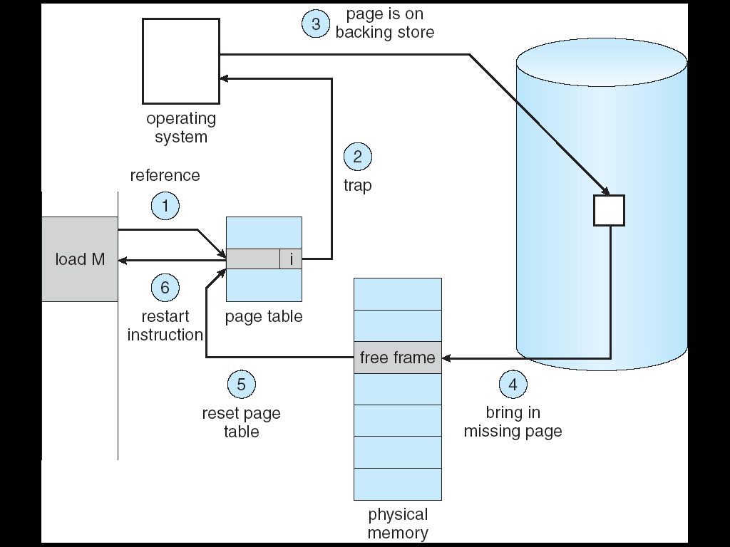
Steps in Handling a Page Fault
detected by hardware
3
V

Slide 49
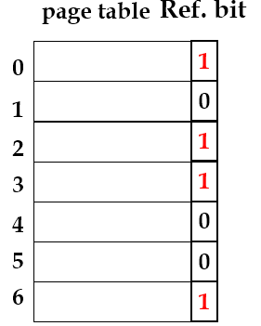
Page Table in OS
out eax, 0x60;
…
add eax, ebx;
CPU
Page table
OS

Slide 50
Q: 有沒有可能一直發生page fault? (使用者會非常不滿意)
Ans: No.

Slide 51
Q: 為什麼不會一直發生page fault?

Slide 52
More about Demand Paging
Q: why demand paging is useful?
i.e., without causing many page faults
Answer: Locality of reference
Result in very low page faults
In turn result in reasonable performance for demand paging

Slide 53
Locality
Locality of reference
Temporal locality
A data/instruction which is recently accessed/executed have high chances of access/execution again
Spatial locality
All those data/instructions which are stored nearby to the recently accessed/executed data/instruction have high chances of access/execution

Slide 54
Outline
Background
Demand Paging
Basic Concepts
Performance of Demand Paging
Copy-on-Write
Page Replacement
Page Replacement Algorithm
Allocation of Frames
Thrashing
Memory Compression
Allocating Kernel Memory
Other Considerations

Slide 55
Performance of Demand Paging
Demand paging can significantly affect the performance of a computer system
Page Fault Rate: 0 ≤ p ≤ 1.0
If p = 0, no page faults
If p = 1, every reference is a fault
Effective Access Time (EAT)
EAT = (1 – p) x memory access time + p x page fault time
To derive EAT, we must know page fault time

Slide 56
Page Fault Time (Skip!)
A page fault causes the following sequence to occur
Trap to the operating system
Determine that the trap was a page fault
Check that the page reference was legal
Determine the location of the page on the disk
Save the user registers and process state
Issue a read from the disk to a free frame
While waiting, allocate the CPU to some other user processes
Receive an interrupt from the disk (I/O completed)

Slide 57
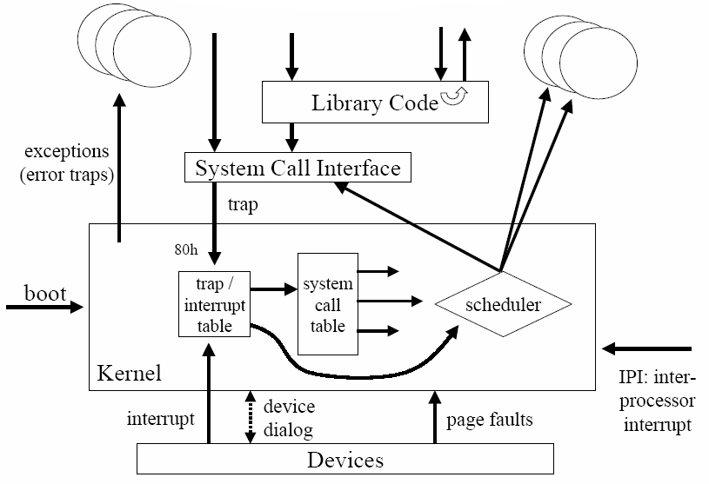
複習: Summary

Slide 58
out eax, 0x60;
…
add eax, ebx;
CPU
…
Page table
OS

Slide 59
Page Fault Time (Cont.) (Skip!)
Save the registers and process state for the other user processes
Determine that the interrupt was from the disk
Correct the page table to show page is now in memory
Wait for the CPU to be allocated to this process again
Restore the user registers, process state, and new page table, and then resume the interrupted instruction
Three major task components of the page-fault service time
Service the trap – several hundred instructions needed
Read the page from the disk– lots of time
Restart the process – again just a small amount of time

Slide 60
Example: Performance of Demand Paging
Assume memory access time = 200 nanoseconds
Assume average page-fault service time = 8 milliseconds
EAT = (1 – p) x 200 + p x (8 milliseconds)
= 200 + p x 7,999,800
If one access out of 1,000 causes a page fault, then
EAT = 8.2 microseconds =>This is a slowdown by a factor of 40!!
Thus, page fault rate should be very small
Thanks to the Locality of reference
複習：In Chapter 9, we show that TLB has very high hit ratio. Now you know the reason.
See the following slide

Slide 61
複習: Effective Access Time (Cont.)
Assume: TLB hit ratio = 80%
Effective Access Time (EAT)
EAT = 0.8 x 10 + 0.20 x 20 = 12 ns
Suffer a 20 percent slowdown in memory access time
Consider a more realistic hit ratio of 99%,
Why so hit? (第十章會介紹)
EAT = 0.99 x 10 + 0.01 x 20 = 10.1ns, Implying only 1% slowdown in access time.

Slide 62
Outline
Background
Demand Paging
Copy-on-Write
Page Replacement
Page Replacement Algorithm
Allocation of Frames
Thrashing
Memory Compression
Allocating Kernel Memory
Other Considerations

Slide 63
Motivations
fork() creates a copy of the parent’s address space for child
Problem of fork()
Time consuming: needs memory copy
In some case, the copying may be unnecessary
Why?

Slide 64
複習: Q: 那fork()呢?
Shown later~

Slide 65
我們先看只有呼叫fork(), 沒有呼叫exec()

Slide 66
複習: fork() System Call
code
data
fork()
stack
In fact, they are non-continuous
…
code
data
stack
…
In fact, they are non-continuous

Slide 67
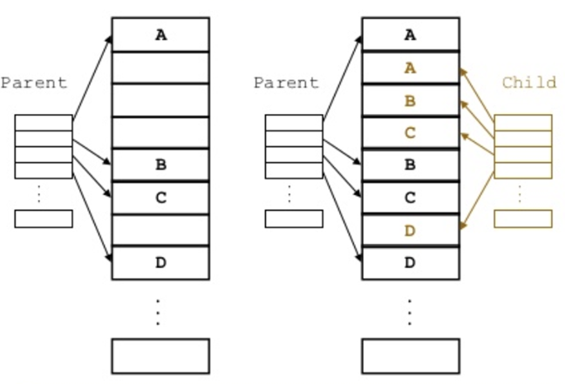
複習: fork() System Call
In fact, child’s pages are demand paged in.

Slide 68
觀察: 沒有呼叫exec()
觀察 1：
如果沒有呼叫exec()，parent 和 child可以共享code section
觀察 2：
如果data, stack 和heap sections沒有寫入動作，parent 和 child也可以共享
code
data
fork()
stack
…
code
data
stack
…

Slide 69
如果有呼叫fork()和exec()

Slide 70
複習: fork()and exec()
parent
Copy from original image
fork()
Original image
In fact, they are non-continuous
Load another image
child
exec()
In fact, they are non-continuous

Slide 71
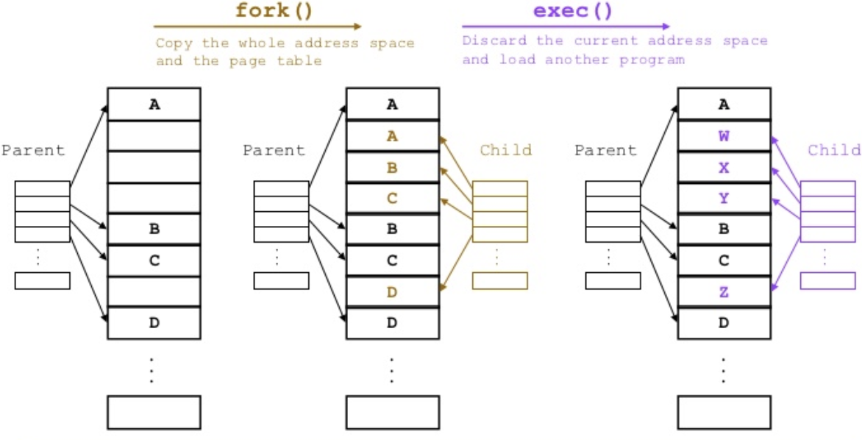
複習: fork()and exec()
In fact, after exec(), child’s pages are demand paged in.
https://ss.csdn.net/p?https://upload-images.jianshu.io/upload_images/195230-727dc95e50684064.png

Slide 72
觀察: 呼叫exec()
觀察 3：
如果child呼叫exec()，則fork()時的copy不需要
parent
Copy from original image
fork()
Original image
Load another image
child
exec()

Slide 73
Q: 怎麼辦呢?

Slide 74
Copy-on-Write
Solutions: Copy-on-Write
Upon fork(), do not copy.
Parent and child share the same physical memory
Question 1: But, if child process writes data/stack/heap
Cannot share anymore
Solutions: Copy-on-Write (COW)
Question 2: If child process invoke exec()?
Just load the new image by demand paging

Slide 75
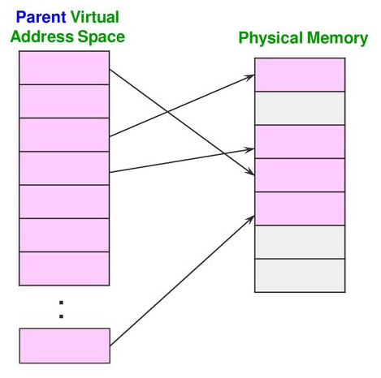
Copy-on-Write: Before Fork()
https://slideplayer.com/slide/13869430/

Slide 76
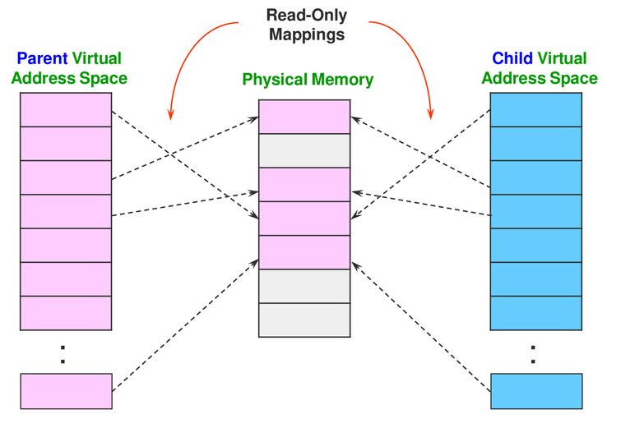
Copy-on-Write: After Fork()
https://slideplayer.com/slide/13869430/

Slide 77
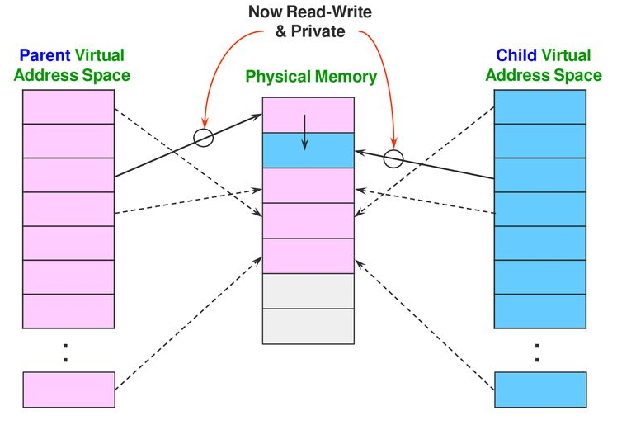
Copy-on-Write: Child Does not Call exec() But Performs write() to Page 2
Child writes page 2
https://slideplayer.com/slide/13869430/

Slide 78
Another Example

Slide 79
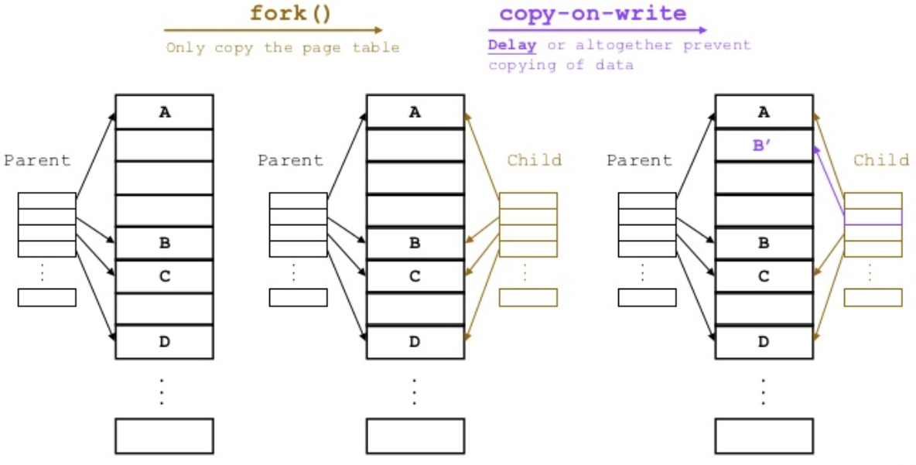
Process Creation: with Copy-on-Write
Child writes page 2, i.e, B ⇨ Copy B to frame 1 and modify it to B’
https://ss.csdn.net/p?https://upload-images.jianshu.io/upload_images/195230-727dc95e50684064.png

Slide 80
Q：可以不copy而直接write嗎？

Slide 81
Copy-on-Write
Upon fork(), do not copy.
Parent and child share the same physical memory
Question 1: But, if child process writes data/stack/heap
Cannot share anymore
Solutions: Copy-on-Write (COW)
Question 2: If child process invoke exec()?
Just load the new image by demanding paging

Slide 82
The fork() System Call: With Page Sharing
Virtual Memory
Virtual Memory
Physical Memory
program image
fork()
parent
program image
share
child
In fact, they are non-continuous
NCHU System & Network Lab

Slide 83
The exec()System Call: Load the New Image
Virtual Memory
Virtual Memory
Physical Memory
program image
exec()
fork()
parent
program image
child
Load another image
NCHU System & Network Lab

Slide 84
Again, loading the new image is dony by demand paging.

Slide 85
Q: How to implement Copy-on-Write?
Hint: 如何讓CPU跳到OS?
(因為OS要copy並修改page table)

Slide 86
複習: 如何讓CPU跳到OS?
…
mov eax, 10
mov temp, eax
…
CPU
…..
eax | 10
OS

Slide 87
Q: 如何產生exception?
Hint: 參考page fault的處理(valid/invalid bit)
Sol.: add copy-on-write bit in the page table entries (similar to the page fault handling)

Slide 88

Q: If P₁ Writes to Page 3, What Happened?
A
1
B
1
D
C
1
1
D
A
A
1
B
1
B
C
1
1
D
C
A
1
B
1
C
1
1
D
Copy-on-write bit

Slide 89
Copy-on-Write Example
See the following slide
Upon fork(), create a new page table for the child that maps to all of the parents pages
Parent and child initially shares the same page frames
Mark all of the pages as copy-on-write
If parent or child writes to a page, a protection exception (or copy-on-write fault) will be triggered
CPU jump to OS
OS copy the target page, reset the page table and
Finally, restarts the write operation
CS 5600 Computer Systems

Slide 90
Example
Physical Memory
Parents Page Table
2³⁰
Kernel Memory
VPN | PFN | Copy-on-Write
1 | 5 | 0
2 | 9 | 0
3 | 2 | 0
fork()
9
Heap
1
7
Protection Exception
Stack
7
1
Write
0
5
Code
Childs Page Table
 | PFN | Copy-on-Write
1 | 5 | 0
2 | 9 | 1
3 | 2 | 1
2
Stack
Write
0
parent writes page 3 (frame 2)
0
CS 5600 Computer Systems

Slide 91
複習: Event-Driven OS
OS is event-driven
Events
Interrupt: driven by hardware
Trap (or exception): a software-generated interrupt
Error: Division by zero, illegal instructions, page fault trap, copy-on-write fault trap
System calls: functions provided by OS to provide service to applications
Ex: read(), write(), open()……

Slide 92
Outline
Background
Demand Paging
Copy-on-Write
Page Replacement
Page Replacement Algorithm
Page buffering Algorithm
Allocation of Frames
Thrashing
Memory Compression
Allocating Kernel Memory
Other Considerations

Slide 93
Question: upon page faults, how to do if physical memory is full (free frame list is empty) ?

Slide 94
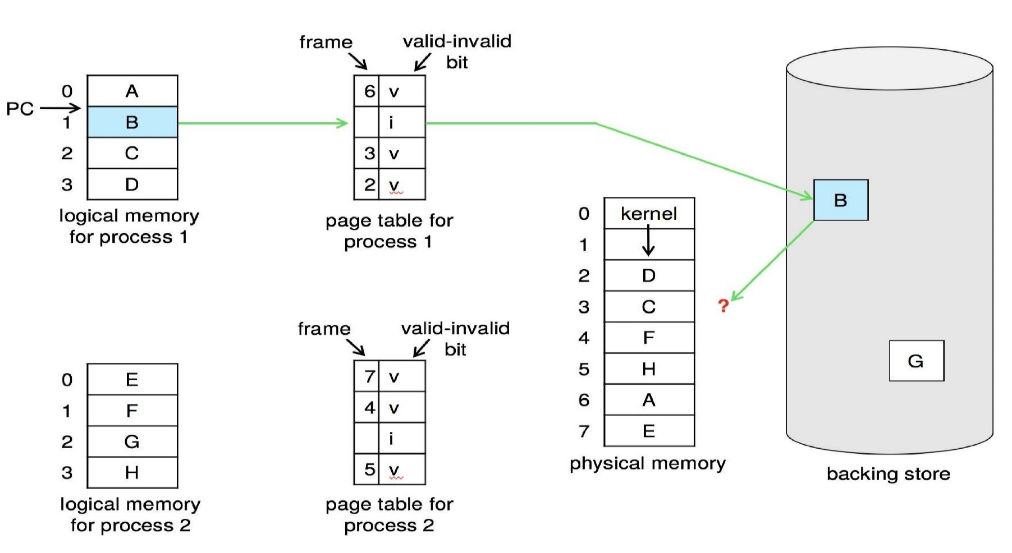
Demand Paging: Physical Memory is Full
All frames are in use

Slide 95
Question: upon page faults, how to do if physical memory is full (free frame list is empty) ?
Answer: Page Replacement

Slide 96
Page Replacement
Page replacement
Find a page frame in memory, page it out.
And then page in the desired page

Slide 97
Page Replacement
Page not in physical memory
I
I
B
Page Replacement

Slide 98
Basic Page Replacement
See the following slide
Select a victim frame and page out the victim frame to the disk
Change the page and frame tables
Page in the desired page into the (newly) free frame;
Update the page and frame tables
Restart the process

Slide 99
Page Table When Some Pages Are Not in Main Memory
In-valid
0
i
F
F`
F`

Slide 100
Page Table When Some Pages Are Not in Main Memory
9
v
0
i
B
F`

Slide 101
請完成動畫: If frame 5 is Selected as Victim
All frames are in use

Slide 102
Reduce Page Replacement Overhead
Page replacement:
☹: Two page transfers
Q: 怎麼辦呢?
只前看到的都是OS在填page table的內容
事實上, MMU也會填modify bit in each page table entry

Slide 103
Page Table in OS
out eax, 0x60;
…
add eax, ebx;
CPU
Page table
OS

Slide 104
Reduce Page Replacement Overhead
Solution: modify bit (or dirty bit)
Each page frame is associated with a modify bit
Set by the hardware if a frame page is modified
Reduce overhead– only modified pages are written to disk
If m = 1, write back to disk
If m = 0, directly replace the page

Slide 105
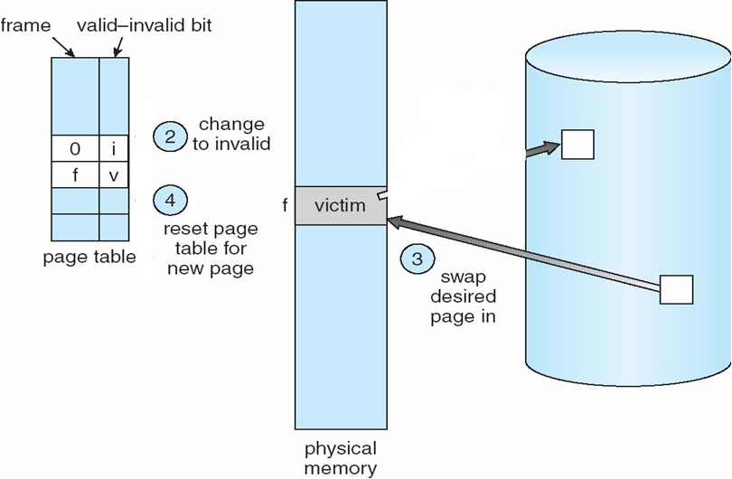
Page Replacement with Modify Bit
m
1
If m=1
write back to disk
victim

Slide 106
Outline
Background
Demand Paging
Copy-on-Write
Page Replacement
Page Replacement Algorithm
Page buffering Algorithm
Allocation of Frames
Thrashing
Memory Compression
Allocating Kernel Memory
Other Considerations

Slide 107
Two Major Problems to Implement Demand Paging
Page-replacement algorithm
Which frame is to be replaced ?
Goal: result in minimum number of page faults
Frame-allocation algorithm
How many frames are allocated to a process ?
Introduced later

Slide 108
Page Replacement Algorithm: Which Frame is Selected as the Victim Frame?

Slide 109
Page Replacement Algorithms
FIFO algorithm
Stack Algorithm
Optimal algorithm
LRU algorithm
LRU approximation algorithms
Additional-reference-bits algorithm
Second-chance algorithm
Enhanced second-chance algorithm
Counting algorithm
LFU
MFU

Slide 110
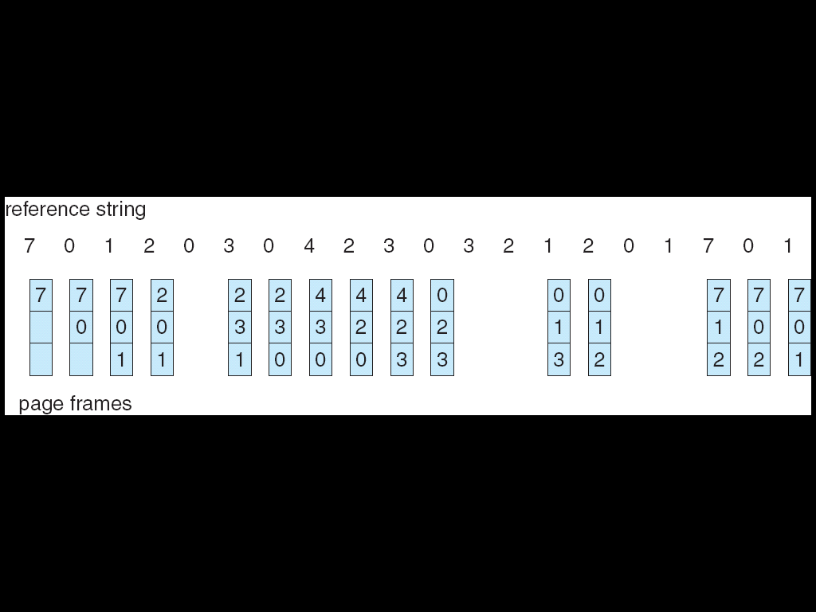
FIFO Page Replacement
15 page faults in this case

Slide 111
再看一個例子

Slide 112
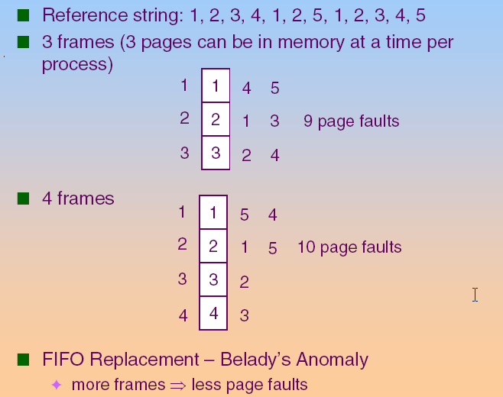
First-In-First-Out (FIFO) Algorithm

Slide 113
FIFO Page Replacement
上述例子是否很奇怪?
FIFO suffers from the belady’s anomaly
Belady’s Anomaly
allocated frames ↑ ⇒ page-fault rate ↑

Slide 114
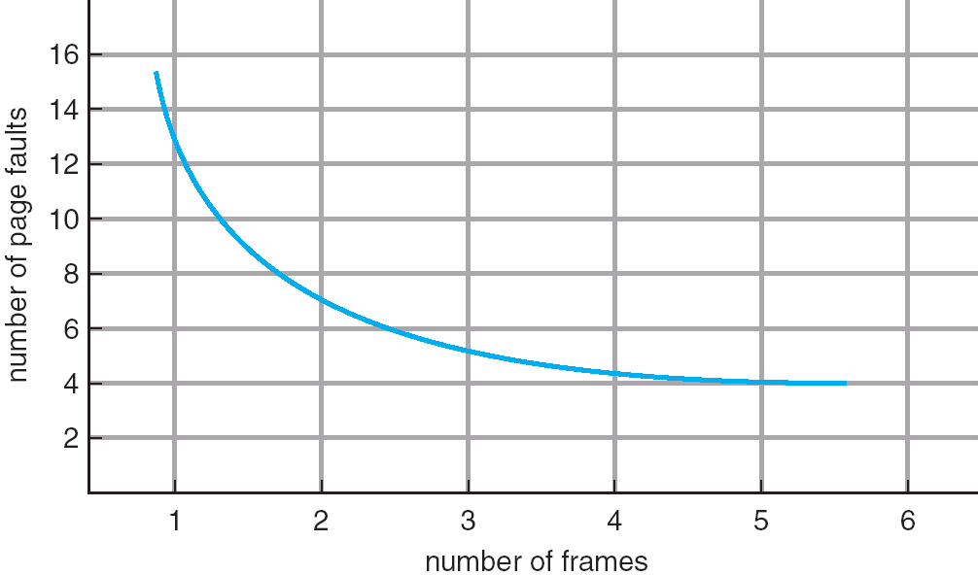
Graph of Page Faults Versus the Number of Frames: Normal Case

Slide 115
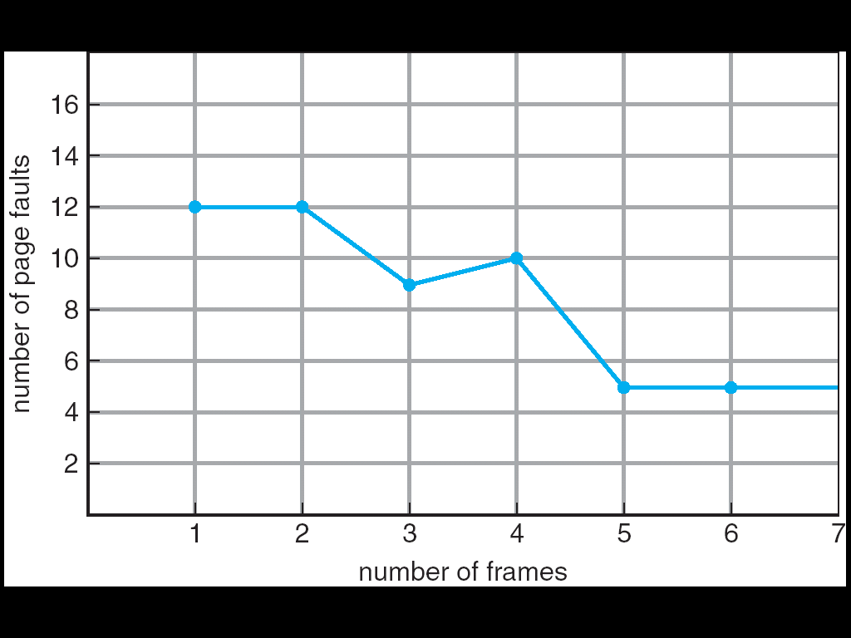
FIFO Illustrating Belady’s Anomaly

Slide 116
Page Replacement Algorithms
FIFO algorithm
Stack Algorithm
Optimal algorithm
LRU algorithm
LRU-approximation algorithms
Additional-reference-bits algorithm
Second-chance algorithm
Enhanced second-chance algorithm
Counting algorithm
LFU
MFU

Slide 117
Stack Algorithm
Not a specific page replacement algorithm
Stack algorithm:
Assume physical memory has n frames
If physical memory becomes n+1 frames, above n frames must also be in physical memory
Stack algorithms do not suffers from Belady's anomaly.
Both optimal algorithm and LRU algorithm are stack algorithm.
FIFO is not a stack algorithm

Slide 118
Page Replacement Algorithms
FIFO algorithm
Optimal algorithm
LRU algorithm
Stack Algorithm
LRU approximation algorithms
Additional-reference-bits algorithm
Second-chance algorithm
Enhanced second-chance algorithm
Counting algorithm
LFU
MFU

Slide 119
Q: 如何選擇victim page可以達到最佳效能?
Hint: 最佳效果=page faults次數最少

Slide 120
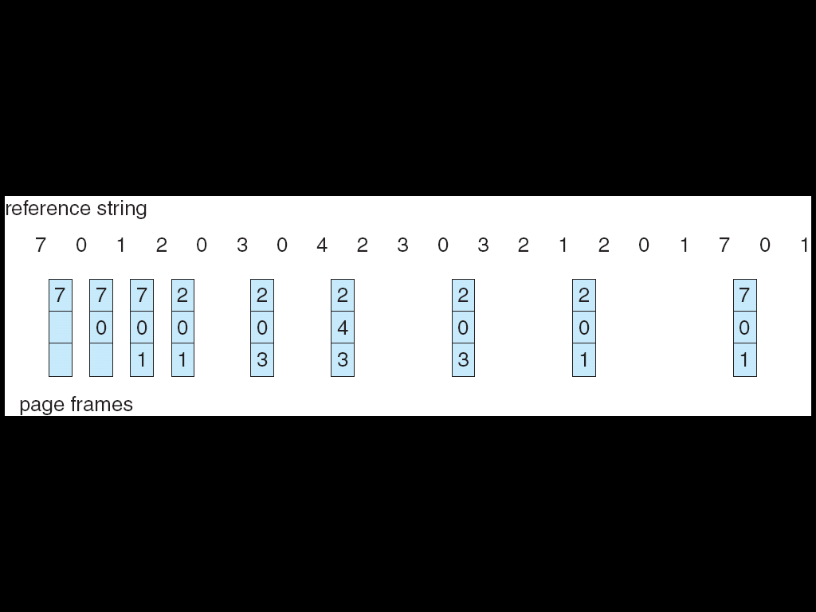
Optimal Algorithm
Replace page that will not be used for longest period of time
9 page faults

Slide 121
Optimal Algorithm (Cont.)
Has the lowest page-fault rate of all algorithms
Never suffers from the belady’s anomaly (a stack algorithm)
Optimal.
But difficult to implement. Why?
Sol.: Need future knowledge

Slide 122
Page Replacement Algorithms
FIFO algorithm
Stack Algorithm
Optimal algorithm
LRU algorithm
LRU-approximation algorithms
Additional-reference-bits algorithm
Second-chance algorithm
Enhanced second-chance algorithm
Counting algorithm
LFU
MFU

Slide 123
Q: 所以我們必須逼近optimal. 如何逼近呢?
Hint: 鑑古以知今

Slide 124
Least Recently Used (LRU)
Replace the page that has not been used for the longest period of time
An approximation of optimal algorithm
Use the recent past as the approximation of the near future
LRU is often used, and is considered as quite good.
Never suffers from the belady’s anomaly (a stack algorithm)

Slide 125
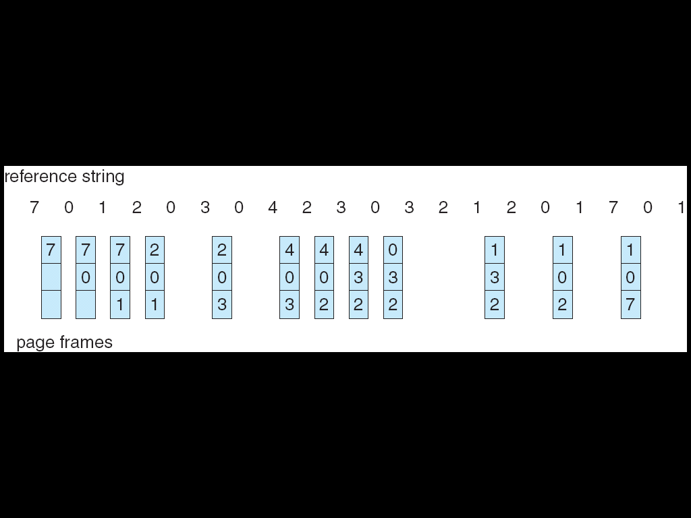
LRU Page Replacement
12 page faults

Slide 126
Q: how to implement LRU?
Hint: 電腦沒有眼睛
Ans: Counters or LRU Stack

Slide 127
Two LRU Implementation Schemes of LRU-Counters
Counter implementation
Every page table entry has a time-of-use field
When a page is referenced,
Write the current time into this field
Select a victim page ⇒ page with the smallest time value
Problems:
Require a search of the page table to find the LRU page,
A write to memory (i.e., time-of-use field in page table) for each memory access
Overflow of the clock must be considered

Slide 128
Time-of-Use Field in Each Page Table Entry
time-of-use
4
3
6

Slide 129
Q: 最大的問題, 誰來寫time-of-use?
Hint:不可能是OS, shown later

Slide 130
複習: OS不知道發生記憶體存取
…
mov eax, 10
mov temp, eax
…
CPU
…..
eax | 10
OS

Slide 131
Two LRU Implementation Schemes-LRU Stack
LRU Stack implementation –
Keep a stack of page numbers in a double linked list
Page referenced:
Move it to the top
No search for replacement
See the next slide

Slide 132
LRU Stack Implementation Example
LRU is realized by an LRU stack
Move block 3 to the top of stack
hit
7
1
3
If memory size = 8 frames
⇨ stack has 8 entries
Hit to block 3
6
5
LRU stack

Slide 133
LRU Stack Implementation Example
LRU is realized by an LRU stack
miss
Load block 9 from disk
9
Disk
Miss to block 9
9
3
1
Put block 9 on the stack top
7
block at the bottom (block 2) is victim
6
2
LRU stack

Slide 134
Q: 同樣的問題, 誰來負責維護LRU stack呢?
Hint:一樣不可能是OS, shown later

Slide 135
Two LRU Implementation Schemes
But…
Counters and LRU stack implementation schemes require substantial hardware assistance.
Updating the clock field or the LRU stack must be done for every memory reference
Need hardware support
See the following two slides

Slide 136
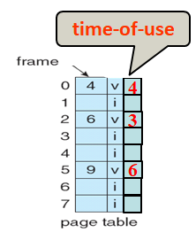
Update Page Table for Each Memory Access
…
out eax, 0x60;
…
add eax, ebx;
…
CPU
…..
OS

Slide 137

Update LRU Stack for Each Memory Access
…
out eax, 0x60;
…
add eax, ebx;
…
CPU
OS

Slide 138
Q: 問題是沒有硬體提供上述的支援. 怎麼辦呢?
Ans:逼近LRU演算法

Slide 139
Page Replacement Algorithms
FIFO algorithm
Stack Algorithm
Optimal algorithm
LRU algorithm
LRU-approximation algorithms
Additional-reference-bits algorithm
Second-chance algorithm
Enhanced second-chance algorithm
Counting algorithm
LFU
MFU

Slide 140
LRU Approximation Algorithms
LRU need hardware support
Few systems provide sufficient hardware support for LRU
除了dirty bit, MMU也會對每一個page table entry設定reference bit
Can be utilized to approximate LRU scheme
Reference bit
Each page associated with a reference bit, initially set to 0 by OS
When a page is referenced, hardware set this bit to 1

Slide 141
Reference Bit
reference string: 0
2
3
6
page number
page table
reference bit
1
0
0
1
0
0
2
1
1
3
0
4
0
5
0
6
0
1

Slide 142
Page Table in OS
out eax, 0x60;
…
add eax, ebx;
CPU
Page table
OS

Slide 143
Q: When page replacement occurs, 我們要替換誰呢?
Hint: replace the one with 0
Q: 但是如果有很多0呢?

Slide 144
Reference Bit
reference string: 0
2
3
6
page number
page table
reference bit
0
1
1
0
2
1
when replacement, select which one?
1, or 4, or 5
3
1
4
0
5
0
6
1

Slide 145
Page Replacement Algorithms
FIFO algorithm
Optimal algorithm
LRU algorithm
Stack Algorithm
LRU-approximation algorithms
Additional-reference-bits algorithm
Second-chance algorithm
Enhanced second-chance algorithm
Counting algorithm
LFU
MFU

Slide 146
LRU Approximation Algorithms- Additional-reference-bits Algorithm
Additional-reference-bits Algorithm
Get additional ordering information
Keep several history bits for each page in a table in memory
Periodically, shift the reference bit to the MSB bit (discarding the LSB bit)
Replace the page with smallest number

Slide 147
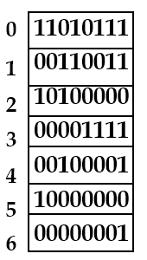
Page Table and History Table in OS
out eax, 0x60;
…
add eax, ebx;
CPU
Page table
history table
OS

Slide 148
History by Additional Reference Bits
reference string: 0, 2, 3, 6
(k=8)
history
11010111
00110011
10100000
00001111
00100001
10000000
00000001
new
11101011
00011001
11010000
10000111
00010000
01000000
10000000
reference bit
1
0
1
1
0
0
1
0
1
2
3
4
5
6
The page (page 4) with the lowest number can be replaced
page number

Slide 149
Page Replacement Algorithms
FIFO algorithm
Stack Algorithm
Optimal algorithm
LRU algorithm
LRU-approximation algorithms
Additional-reference-bits algorithm
Second-chance algorithm
Enhanced second-chance algorithm
Counting algorithm
LFU
MFU

Slide 150
LRU Approximation Algorithms- Second chance Algorithm
Second chance, also called Clock Algorithm
FIFO + reference bit
Use FIFO selection of pages for replacement
If selected page has reference bit=0, replace the page
If selected page has reference bit=1, then give it a second chance:
Clear reference bit to 0,
Leave the page in memory,
Select next FIFO page,
If the page is used often enough, it will never been replaced
Since the reference bit always = 1

Slide 151
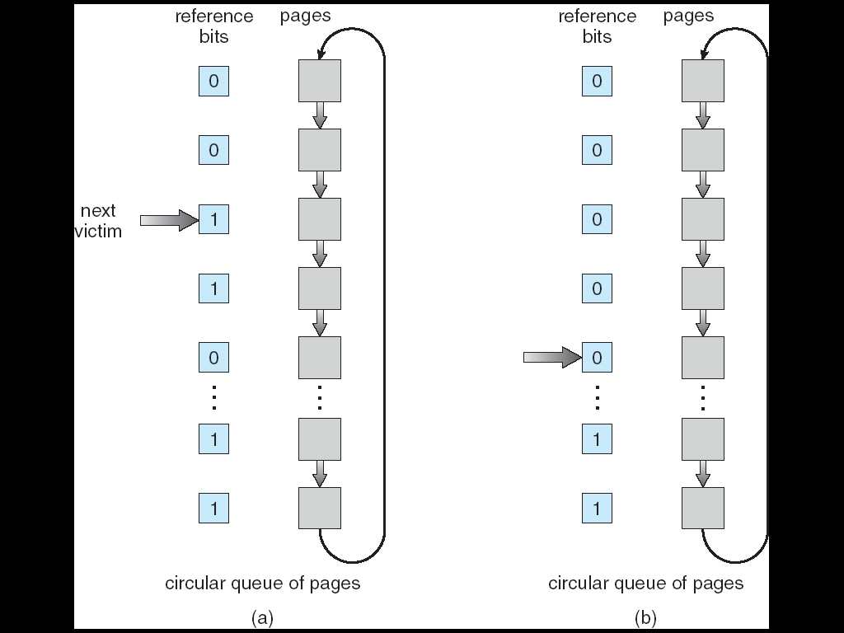
Second-Chance (Clock) Page-Replacement Algorithm
give second chance
Use a circular queue to implement

Slide 152
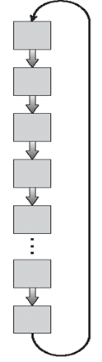
Page Table and FIFO Queue in OS
out eax, 0x60;
…
add eax, ebx;
CPU
Page table
FIFO queue
OS

Slide 153
Page Replacement Algorithms
FIFO algorithm
Stack Algorithm
Optimal algorithm
LRU algorithm
LRU-approximation algorithms
Additional-reference-bits algorithm
Second-chance algorithm
Enhanced second-chance algorithm
Counting algorithm
LFU
MFU

Slide 154
之前提過MMU會設定page table中的modify bit (dirty bit), 也可以拿來利用!

Slide 155
LRU Approximation Algorithms- Enhanced Second Chance Algorithm
Reference bit + modify bit
The pair (reference bit, modify bit), categorized into four classes
(0,0): neither used and dirty – best page to replace
Why check the modify bit? Reduce I/O
(0,1): not used but dirty – not quite as good
The page will need to be written out before replacement
(1,0): used but clean – probably will be used again soon
(1,1): used and dirty – (0, 1) + (1,0)
Replace the first page encountered in the lowest nonempty class
See the next slide

Slide 156
Enhanced Second-Chance Page-Replacement Algorithm
1
1
0
give second chance
0
1
1
0
0
0
0
0
0
1
0
Modified bits
Use a circular queue to implement

Slide 157

Page Table and FIFO Queue in OS
out eax, 0x60;
…
add eax, ebx;
CPU
Page table
FIFO queue
OS

Slide 158
Page Replacement Algorithms
FIFO algorithm
Optimal algorithm
LRU algorithm
Stack Algorithm
LRU approximation algorithms
Additional-reference-bits algorithm
Second-chance algorithm
Enhanced second-chance algorithm
Counting algorithm
LFU

Slide 159
Counting-Based Page Replacement Algorithms
Keep a counter of the number of references that have been made to each page
LFU Algorithm (least frequently used) :
Replaces page with smallest count (最少被使用到)

Slide 160
LRU Page Replacement
12 page faults

Slide 161
But counting-based algorithm is uncommon Why?

Slide 162
Outline
Background
Demand Paging
Copy-on-Write
Page Replacement
Page Replacement Algorithm
Page buffering algorithm
Allocation of Frames
Thrashing
Memory Compression
Allocating Kernel Memory
Other Considerations

Slide 163
Page Buffering Algorithms
Several buffering mechanism to reduce the page faults overhead
Keep a pool of free frames
Write back the modified pages to the disk when the disk is idle
Remember which page was in each free frame

Slide 164
Page Buffering Algorithms
Several buffering mechanism to reduce the page faults overhead
Keep a pool of free frames
Write back the modified pages to the disk when the disk is idle
Remember which page was in each free frame

Slide 165
Keep a Pool of Free Frames
Keep a pool of free frames
Invoking page replacement until there is no free memory is not adopted by OS.
Page replacement is in fact invoked when free memory is below a threshold.
Why?
Obtain a free frame from the pool before the victim is written out
Allows the process to restart as soon as possible

Slide 166
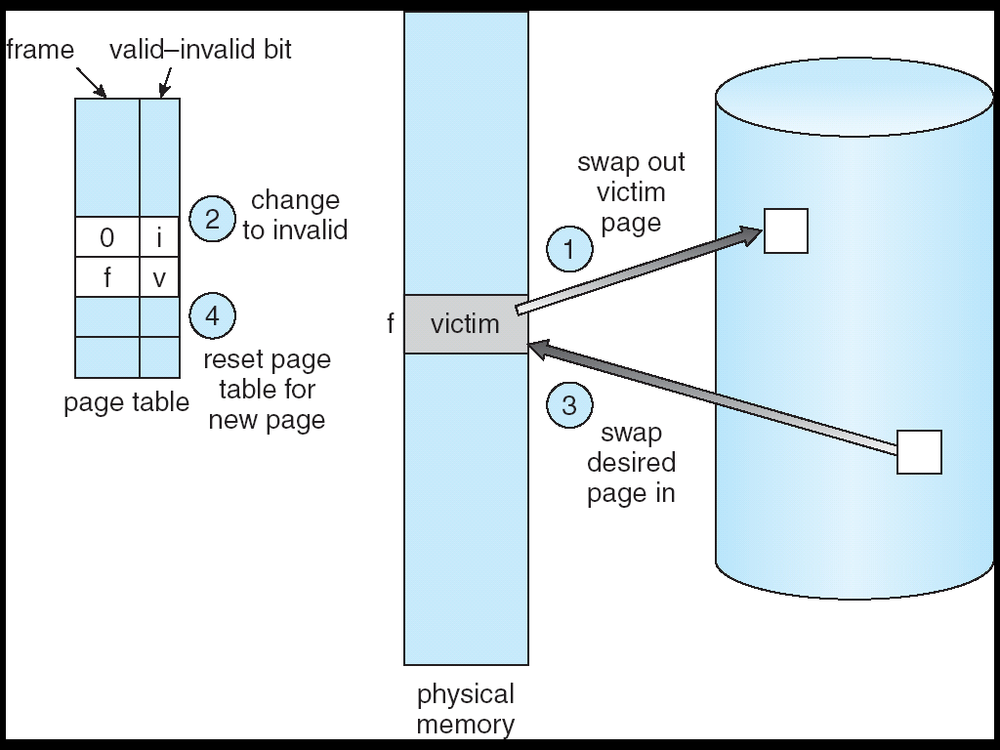
Page Replacement: Original
Must wait for the page out of victim page

Slide 167
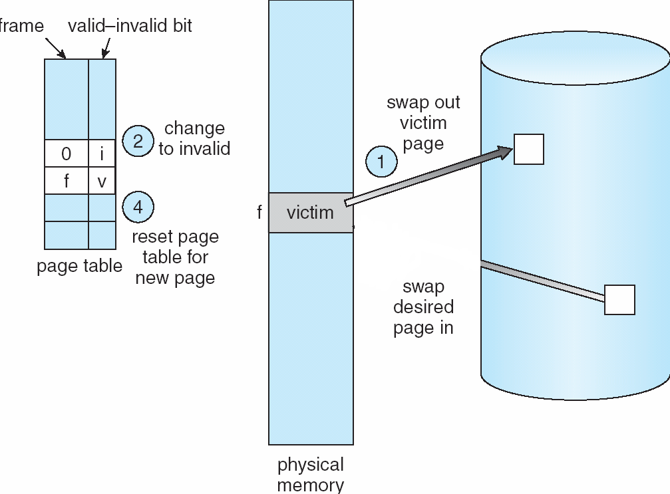
Page Replacement-Maintain Free Frames
4
3
2
1
free frames
Without waiting for the page out of victim pages

Slide 168
Page Buffering Algorithms
Several buffering mechanism to reduce the page faults overhead
Keep a pool of free frames
Write back the modified pages to the disk when the disk is idle.
Remember which page was in each free frame

Slide 169
Write Back the Modified Pages to Disk When Disk is Idle
Write back the modified pages to the disk when the disk is idle.
Why?
Ans.: when it is selected for replacement, no need to be written out

Slide 170
Page Replacement: Original
Must wait for the page out of victim page

Slide 171
Page Replacement: New
1
3
2
1
Without wait for the page out of victim page

Slide 172
Page Buffering Algorithms
Several buffering mechanism to reduce the page faults overhead
Keep a pool of free frames
Write back the modified pages to the disk when the disk is idle
Remember which page was in each free frame

Slide 173
Remember Which Page was in Each Free Frame
Remember which page was in each free frame
Why?
Ans.: The old page can be reused from the free-frame pool
See the following slide

Slide 174
Page Replacement- Remember Which Page was in Each Free Frame
10
23
free frames
23
page faults
15
8
Compared with previous slide, don’t need to page in page 23 from the disk

Slide 175
Outline
Background
Demand Paging
Copy-on-Write
Page Replacement
Page Replacement Algorithm
Page buffering algorithm
Allocation of Frames
Thrashing
Memory Compression
Allocating Kernel Memory
Other Considerations

Slide 176
Two Major Problems to Implement Demand Paging
Page-replacement algorithm
Which frame is to be replaced ?
Goal: result in minimum number of page faults
Frame-allocation algorithm
How many frames are allocated to a process?
Introduced in this and the following subsections

Slide 177
Outline
Background
Demand Paging
Copy-on-Write
Page Replacement
Page Replacement Algorithm
Allocation of Frames
Frame Allocation
Global versus Local Allocation
Thrashing
Memory Compression
Allocating Kernel Memory
Other Considerations

Slide 178
Q: 每一個process應該分配多少記憶體空間?

Slide 179
Allocation Algorithms
How to allocate the free memory among the various processes?
Equal allocation
If 100 frames and 5 processes, give each 20 frames.
Proportional allocation
Allocate according to the size (and priority) of process

Slide 180
但是兩種方法都不好! 應該要動態調整~
Q: 如何動態調整?

Slide 181
Outline
Background
Demand Paging
Copy-on-Write
Page Replacement
Page Replacement Algorithm
Allocation of Frames
Frame Allocation
Global versus Local Allocation
Thrashing
Memory Compression
Allocating Kernel Memory
Other Considerations

Slide 182
Global v.s. Local Allocation
在看動態調整之前, 我們先介紹global and local allocation.
When replacement, which frame is replaced?
Global replacement –
Selects a replacement frame from the set of all frames;
Local replacement –
Each process selects a replacement frame from its own frames
Global replacement is more common
Results in better throughput

Slide 183
Global Replacement or Local Replacement?
All frames are in use

Slide 184
Global Replacement就是一種動態調整機制
Process A page fault, process C的一個page被page out.
Process A新增一個page, process C少一個page

Slide 185
A Example Global Page Replacement Policy
A common strategy to implement global page-replacement policy
When the free-frame list falls below a minimum threshold
A kernel routine, called reapers (收穫者), is triggered to reclaim pages
When reaching a maximum threshold
Reapers are stopped
Ensure there is always free memory to satisfy new requests
Why guarantee free memory is always available instead of using up all free memory?

Slide 186
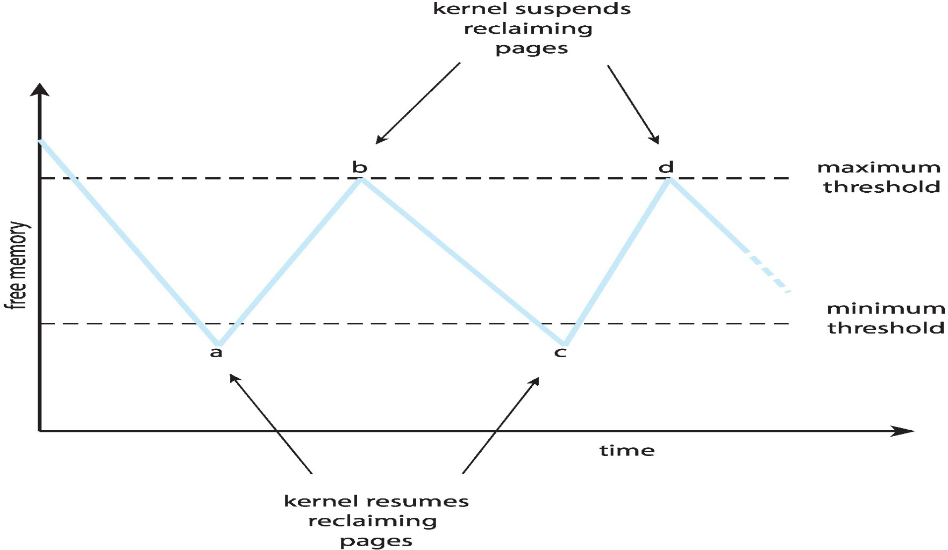
Reclaiming Pages Example

Slide 187
Outline
Background
Demand Paging
Copy-on-Write
Page Replacement
Page Replacement Algorithm
Allocation of Frames
Thrashing
Memory Compression
Allocating Kernel Memory
Other Considerations

Slide 188
因此, 在某些情況下, 有可能某些process被分配到的記憶體空間太少了

Slide 189
Outline
Background
Demand Paging
Copy-on-Write
Page Replacement
Page Replacement Algorithm
Allocation of Frames
Thrashing
Cause of Thrashing
Working-Set Model
Page-Fault Frequency
Memory Compression
Allocating Kernel Memory
Other Considerations

Slide 190
Allocation Algorithms
Problem: if a process does not have enough pages
The page-fault rate is very high since the paged out pages will be paged in soon
This leads to:
Low CPU utilization

Slide 191
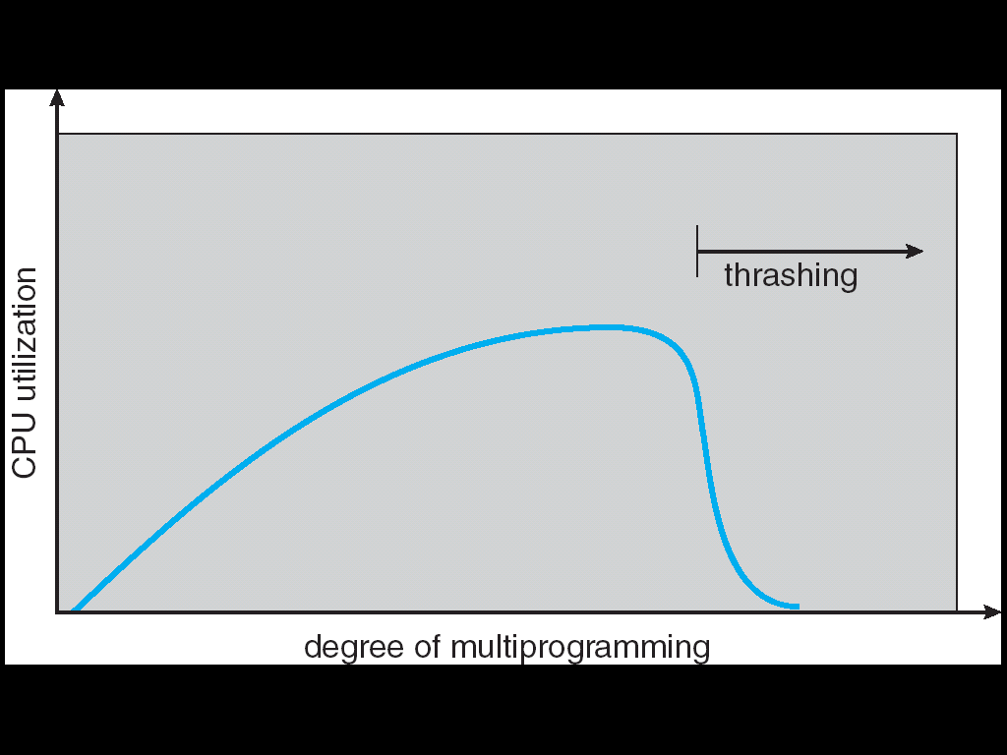
Thrashing
Definition: a process is thrashing if it is spending more time paging than executing
Thrashing = a process is busy paging in and paging out

Slide 192
Locality of References
Why does paging work? Locality Model
A locality: a set of pages that are actively used
Program structure (subroutine, loop, stack)
Data structure (array, table)
See the next slide
As a process executes, it moves from one locality to another
EX: When a function is called, it defines a new locality
Thus, if we can allocate enough frames to include the current localities of all processes ⇒ no thrashing

Slide 193
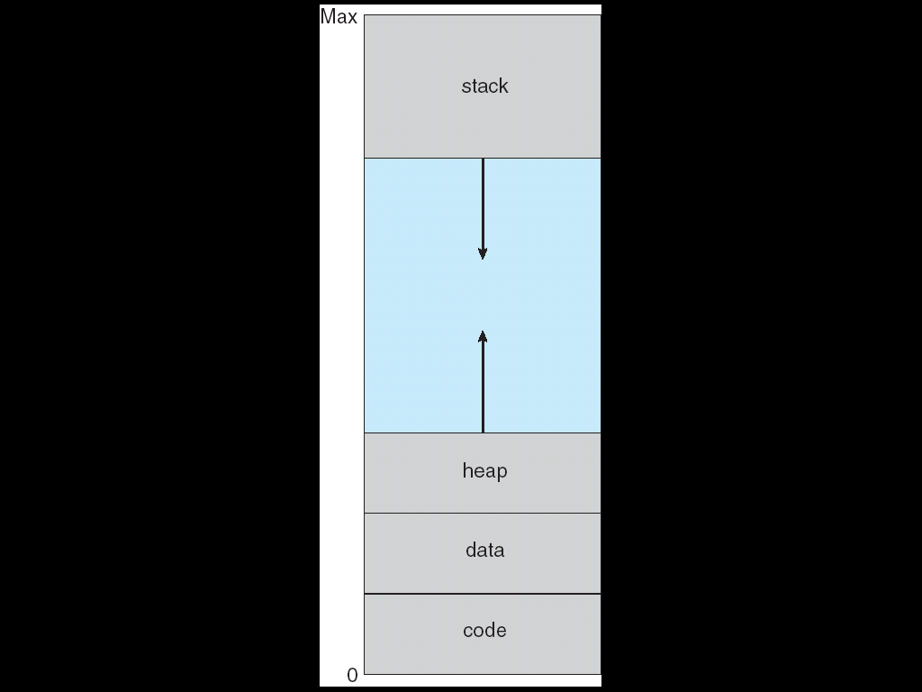
Locality of References
Example:
int[128,128] data;
for (j = 0; j <128; j++) for (i = 0; i < 128; i++) data[i,j] = 0;

Slide 194
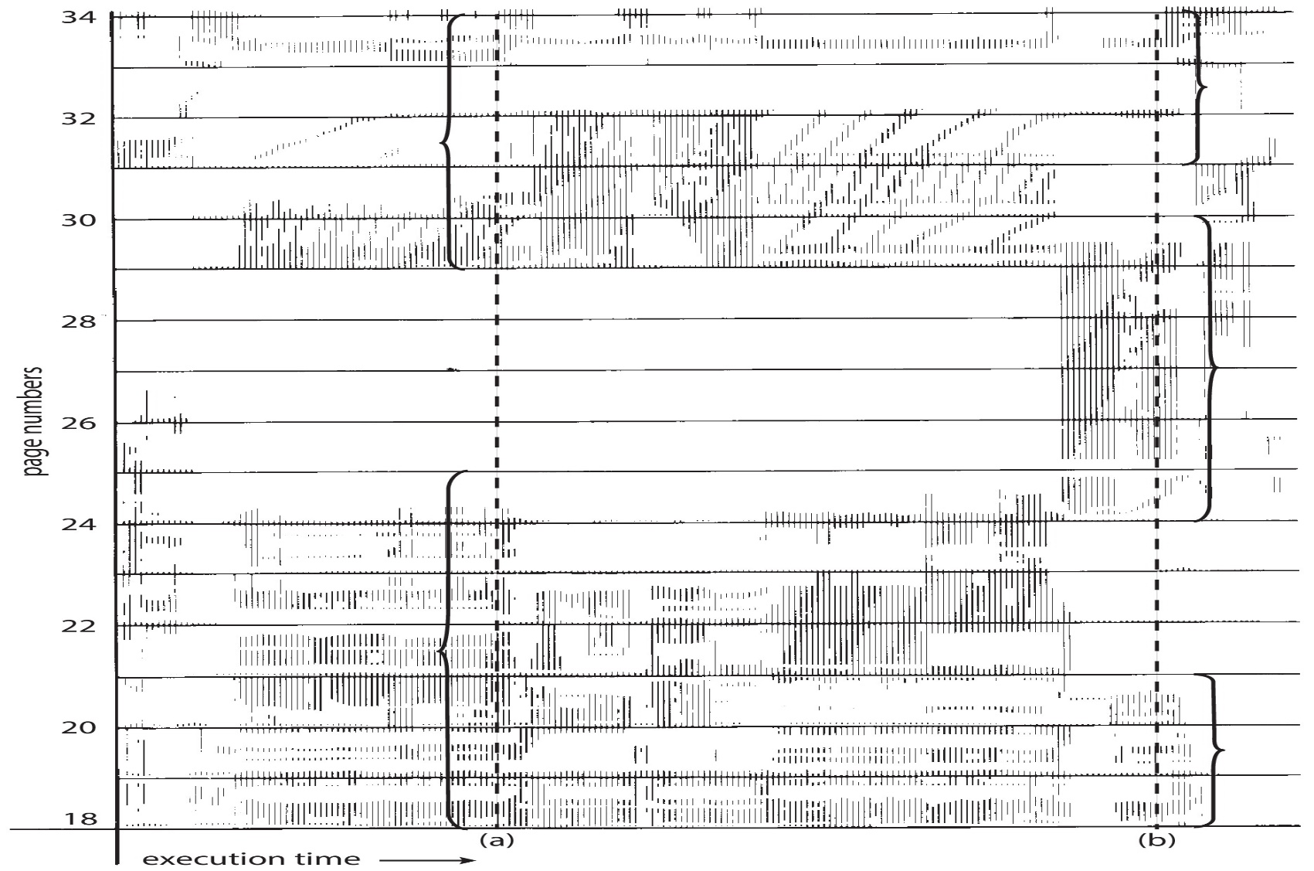
Locality in a Memory-Reference Pattern
At t=(a), locality={18, 19, 20, 21, 22, 23, 24, 29, 30, 33}
At t=(b), locality={18, 19, 20, 24, 25, 26, 27, 28, 29, 31, 32, 33}

Slide 195
Q: 如何知道要分配多少的記憶體空間給process以避免thrashing呢?

Slide 196
Thrashing (Cont.)
To prevent thrashing,
Working-set model
Page-fault frequency

Slide 197
Outline
Background
Demand Paging
Copy-on-Write
Page Replacement
Page Replacement Algorithm
Allocation of Frames
Thrashing
Cause of Thrashing
Working-Set Model
Page-Fault Frequency
Memory Compression
Allocating Kernel Memory
Other Considerations

Slide 198
Working-Set Model
Based on the assumption of locality
Working-set model
Working-set window: a parameter Δ (delta)
Δ = a fixed number of page references
Working set: set of pages in most recent Δ page
Allocate at least WSSi pages for Pi

Slide 199
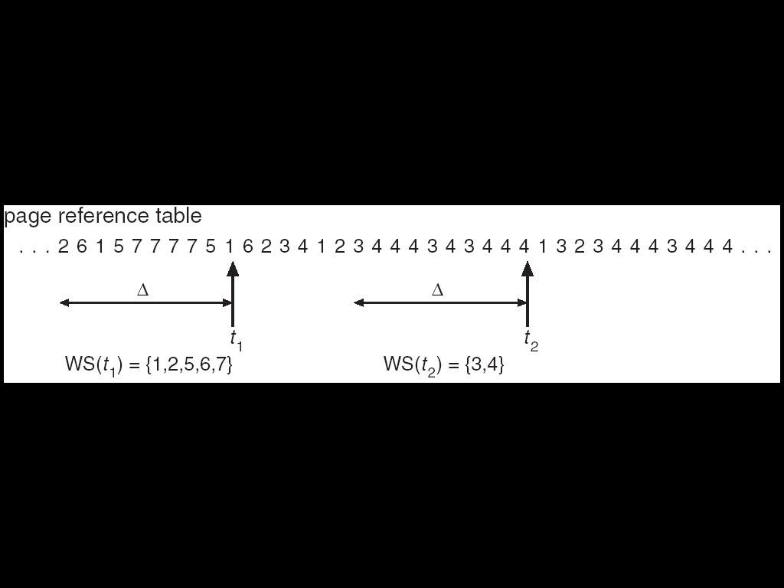
Working-Set Model
Working-set window Δ = 10

Slide 200
如何紀錄working set?

Slide 201
Working-Set Model (Cont.)
But: tracking the WSS at each memory reference is not easy. Why?
See the following slide

Slide 202
如果由OS紀錄WSS?
…
out eax, 0x60;
…
add eax, ebx;
…
CPU
…..
OS

Slide 203
Q: 怎麼辦呢?⇨逼近
Q: 如何逼近呢?

Slide 204
Approximate Working Set
Approximate with interval timer + a reference bit
Reference bit is introduced before
Example (skip!):
See the next two slides
Assume Δ = 10,000 references and timer interrupts every 5000 time units
Keep in memory 2 bits for each page
Whenever a timer interrupts
Copy the reference bits to the in memory bits
Set the values of all reference bits to 0
In case of page fault, examine reference bit + 2 in-memory bits
If one of the three bits = 1 ⇒ this page is in working set

Slide 205
Example
time 0 ~ 5,000 ~ 10,000~
timer interrupt
p₁
0
0
1
1
1
p₂
reference bit
0
0
0
0
0
copy
p₃
…
0
0
0
0
0
in-memory two bits, copied from reference bit

Slide 206
Example
time 0 ~ 5,000 ~ 10,000~
timer interrupt
p₁
0
0
1
1
0
p₂
reference bit
0
0
0
0
0
p₃
…
0
0
0
0
1
in-memory two bits, copied from reference bit

Slide 207
Example
time 0 ~ 5,000 ~ 10,000~
shift
timer interrupt
p₁
1
0
0
1
0
p₂
reference bit
0
0
0
0
0
copy
p₃
…
0
0
1
0
0
in-memory two bits, copied from reference bit

Slide 208
Example (Cont.)
page fault
time 0 ~ 5,000 ~ 10,000~
WS={P1, P3}
p₁
1
0
0
1
0
p₂
reference bit
0
0
0
0
0
p₃
…
0
0
1
0
1
in-memory two bits, copied from reference bit

Slide 209
Page Table and In-Memory Bits in OS
out eax, 0x60;
…
add eax, ebx;
CPU
Page table
In-memory bits
OS

Slide 210
Working-Set Model (Cont.)
Problem
Not easy to determine the Δ
if Δ too small ⇒ will not encompass entire locality
if Δ too large ⇒ will encompass several localities

Slide 211
Outline
Background
Demand Paging
Copy-on-Write
Page Replacement
Page Replacement Algorithm
Allocation of Frames
Thrashing
Cause of Thrashing
Working-Set Model
Page-Fault Frequency
Memory Compression
Allocating Kernel Memory
Other Considerations

Slide 212
Page-Fault Frequency Scheme
Investigation: thrashing has a high page-fault rate
Page fault frequency scheme
See the next slide
Controls the page-fault rate to prevent thrashing
Set upper and lower bounds on the desired page-fault rate
If page fault rate exceeds the upper limit
Allocate the process more frame
If page fault rate falls below the lower limit
Remove frames from the process

Slide 213
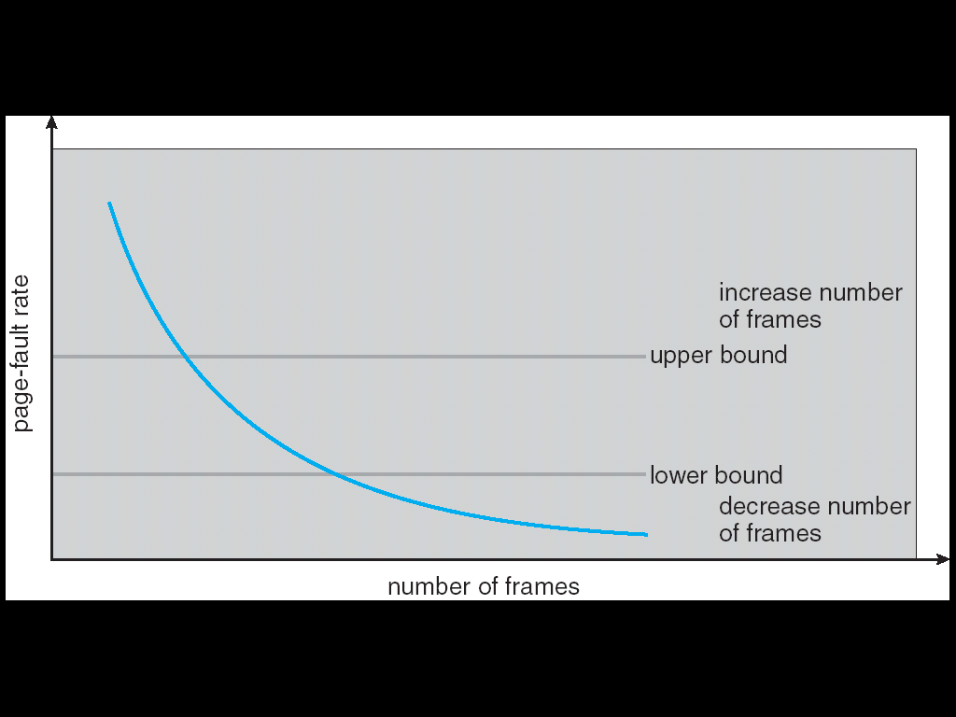
Page-Fault Frequency Scheme

Slide 214
Q: 如果記憶體空間就是真的不夠呢?怎麼辦呢?
Hint: 代表執行太多processes了

Slide 215
Swapping

Slide 216
Outline
Background
Demand Paging
Copy-on-Write
Page Replacement
Page Replacement Algorithm
Allocation of Frames
Thrashing
Memory Compression
Allocating Kernel Memory
Other Considerations

Slide 217
Memory Compression
Why memory compression?
An alternative to page replacement is memory compression.
Used in mobile devices, e.g., Android and iOS
Windows 10 and MacOS also support memory compression

Slide 218
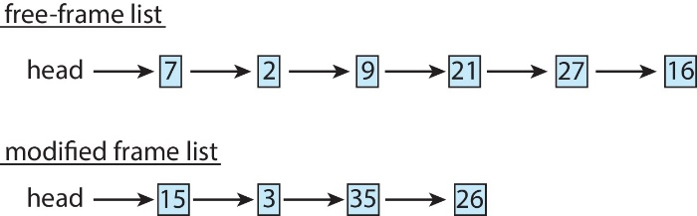
Example: Paging Version
The free-frame list contains six frames, below the minimum threshold
Replacement algorithm selects four frames, 15, 3, 35, 26, to add to the free-frame list
Assume these four frames are dirty
So they need to place on a modified-frame list first, waiting to be written to the disk

Slide 219
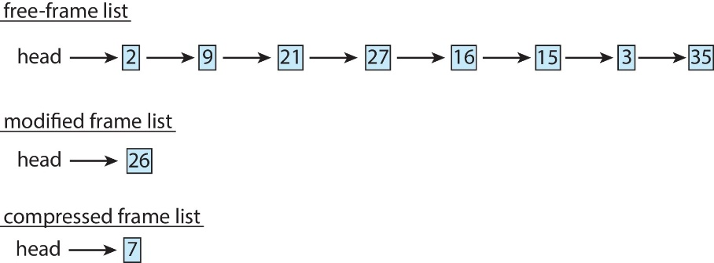
Example: Memory Compression Version
Instead, frame 15, 3, 35 are compressed and stored in frame 7
Assume a frame can only contain three compressed frames

Slide 220
Memory Compression (Cont.) (Skip!)
Mobile devices generally do not support standard paging or swapping
Why? mobile devices use flash memory for storage
Constraint of flash memory
Limited number of erases that flash memory can tolerate
Poor throughput between main memory and flash memory
Thus, mobile devices
Reclaim read-only pages (such as code segment)
Do not need to be paged out
Such data can be demand-paged from the executable file if it is later needed.
Does not page out anonymous memory pages
Anonymous memory : pages not associated with a file, e.g., stack and heap
Memory compression is used if memory becomes constrained.

Slide 221
Outline
Background
Demand Paging
Copy-on-Write
Page Replacement
Page Replacement Algorithm
Allocation of Frames
Thrashing
Memory Compression
Allocating Kernel Memory
Other Considerations

Slide 222
Q: 使用者程式如何動態配置(allocate)新的記憶體空間?
Ans: via malloc()

Slide 223
Q: 呼叫malloc(), OS如何配置記憶體空間給應用程式?
Ans: 從free frame list拿, 並修改page table

Slide 224
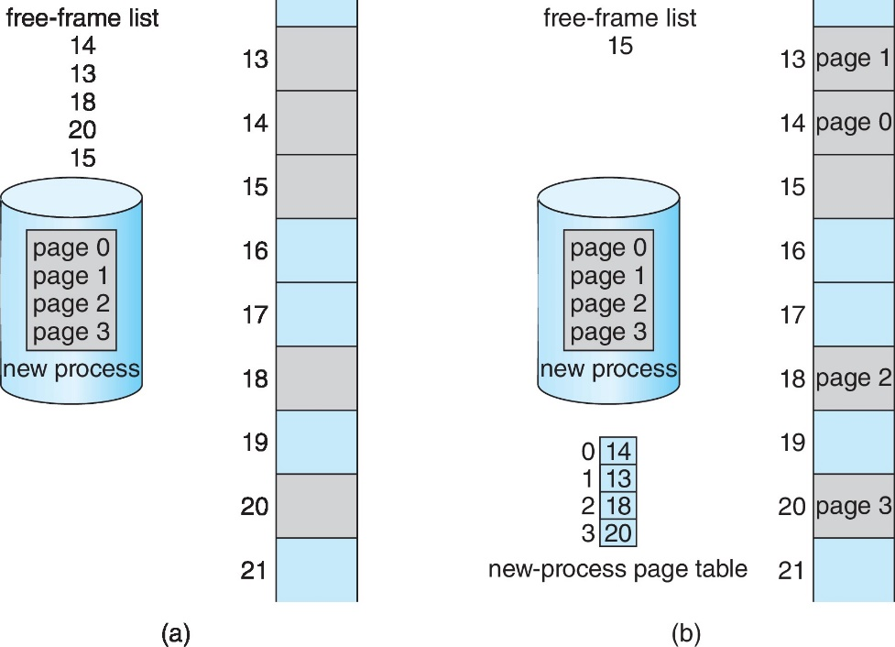
複習: Allocating Frames to a Process
OS maintain a free-frame list
Before Allocation
After Allocation

Slide 225
Q: 這樣分配到的記憶體有什麼特色?

Slide 226
Allocating Kernel Memory
User application requests additional memory
Calls malloc();
OS allocates from the free frames list
Characteristics
Not contiguous and scattered through physical memory (e.g., a 8 KB request may be allocated in frame 5 and 19)
Internal fragmentation since allocated in unit of pages

Slide 227
OS也會動態配置記憶體. 例如?
Ans: PCB, semaphore, mutex, sk_buff…

Slide 228
但是, 從free frame list拿的特性不適合OS. Why?

Slide 229
Allocating Kernel Memory (Cont.)
Why?
Kernel requests memory for data structures, usually less than a page
Minimizes memory waste due to internal fragmentation
Especially, some kernel’s code and data cannot be paged out. Why?
Kernel memory must be used conservatively
Some kernel memory needs memory to be physically contiguous. Why?
Certain hardware devices interact with physical memory

Slide 230
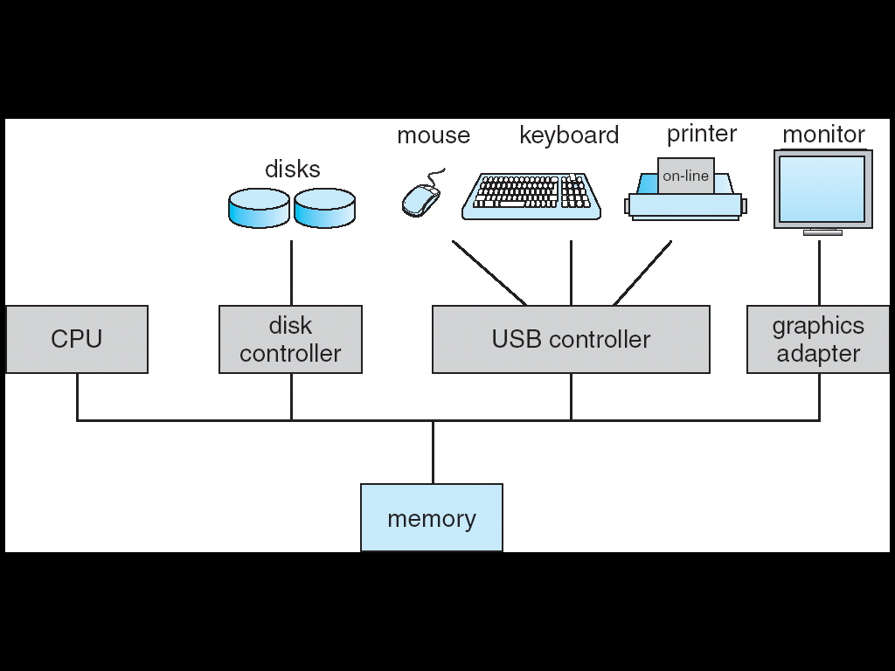
複習: A Computer System
Local buffer

Slide 231
所以, Kernel動態要記憶體會有不同的做法
從另外一個free memory pool拿

Slide 232
Allocating Kernel Memory (Cont.)
Two strategies for managing free memory that is assigned to kernel processes
Buddy system
Slab allocation

Slide 233
Buddy System
Allocates memory from a fixed-size segment
Consist of physically-contiguous pages
Memory allocated using power-of-2 allocator
Satisfies requests in units sized as power of 2
Request rounded up to next highest power of 2
When smaller allocation needed than is available,
Current chunk split into two buddies of next-lower power of 2
Continue until appropriate sized chunk available
Coalescing (聯合)
Adjacent buddies can be combined to a larger segments
See the next slide

Slide 234
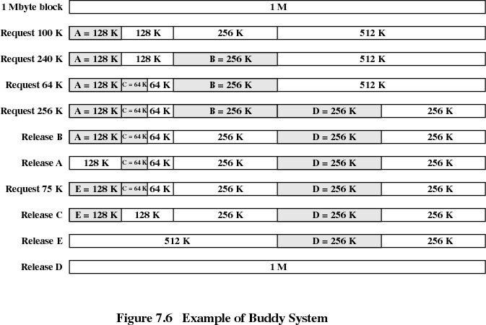

Slide 235
Buddy System (Cont.)
Good:
Physically contiguous
Bad:
Fragmentation due to rounding up to the next highest power of 2
33 KB => 64KB
Sol.: Slab allocation

Slide 236
Slab Allocation
Slab
One or more contiguous frames
Cache
Consists of one or more slabs
Each cache is used for each unique kernel data structure
Ex: Process control blocks, file descriptors, semaphores
Example: a cache consists of 2 slabs and each slab made up of 3 contiguous frames. Thus, a cache is 24-KB. If this cache is for PCB and PCB size = 2KB, this cache can store 12 PCB

Slide 237
Slab Allocation
3KB objects
One cache consisting of two slabs, can store up to eight 3-KB (assume semaphore) objects (two are allocated, six are free)
Another cache consists of two slabs, can store up to six 7-KB (assume PCB) objects (three are allocated, three are free)

Slide 238
Slab Allocation
Benefits:
Physically contiguous
No fragmentation
Fast memory request satisfaction
Objects are created in advance
Objects are released by marking free and return to the cache
Thus, attractive when objects are frequently allocated and freed
Often the case with requests from the kernel

Slide 239
Outline
Background
Demand Paging
Copy-on-Write
Page Replacement
Page Replacement Algorithm
Allocation of Frames
Thrashing
Memory Compression
Allocating Kernel Memory
Other Considerations

Slide 240
Other Considerations
Major decisions of a paging system
Page replacement algorithm
Page allocation policy
Other considerations
Pre-paging
Page size
TLB Reach
Inverted Page Tables
Program Structure
I/O Interlock and Page Locking

Slide 241
Other Considerations
Major decisions of a paging system
Page replacement algorithm
Page allocation policy
Other considerations
Pre-paging
Page size
TLB Reach
Inverted Page Tables
Program Structure
I/O Interlock and Page Locking

Slide 242
Other Issues – Pre-paging
To reduce the large number of page faults at process startup (see the next slide)
Pre-page pages a process will need, before they are referenced
But if prepaged pages are unused
I/O and memory was wasted

Slide 243
Other Issues – Pre-paging
Page faults occurs at the program startup
9 page faults

Slide 244
Other Considerations
Major decisions of a paging system
Page replacement algorithm
Page allocation policy
Other considerations
Pre-paging
Page size
TLB Reach
Inverted Page Tables
Program Structure
I/O Interlock and Page Locking

Slide 245
Other Issues – Page Size
How do we select a page size? (see the following slide)
Page table size (memory overhead) ⇒ large page
Internal fragmentation (memory utilization) ⇒ small page
Internal fragmentation: 1/2 page per process in average
I/O overhead ⇒ large page
Disk I/O is efficient if the data being transferred is large
Better resolution (catching locality) ⇒ small page
Larger page size: some data allocated are not needed
Ex: a program’s locality=100 KB. If page size=200 KB (bad), If page size = 100 KB (good)
Number of page faults ⇒ large page

Slide 246
Paging Model of Logical and Physical Memory

Slide 247
Q: 所以我們希望page size大還是小呢?

Slide 248
Other Issues – Page Size (Cont.)
Trend: larger
CPU speed/memory capacity increase faster than disks.
Memory, process, data sets have become larger
Page faults are more costly today
Ex: In x86-64, a page can be 4KB, 2MB, or 1GB

Slide 249
Other Considerations
Major decisions of a paging system
Page replacement algorithm
Page allocation policy
Other considerations
Pre-paging
Page size
TLB Reach
Inverted Page Tables
Program Structure
I/O Interlock and Page Locking

Slide 250
Other Issues – TLB Reach
TLB Reach : the amount of memory accessible from the TLB
TLB Reach = (TLB Entries) x (Page Size)
See the next slide
Ideally, the working set of each process is stored in the TLB
Otherwise, TLB misses and need to resolve page tables

Slide 251
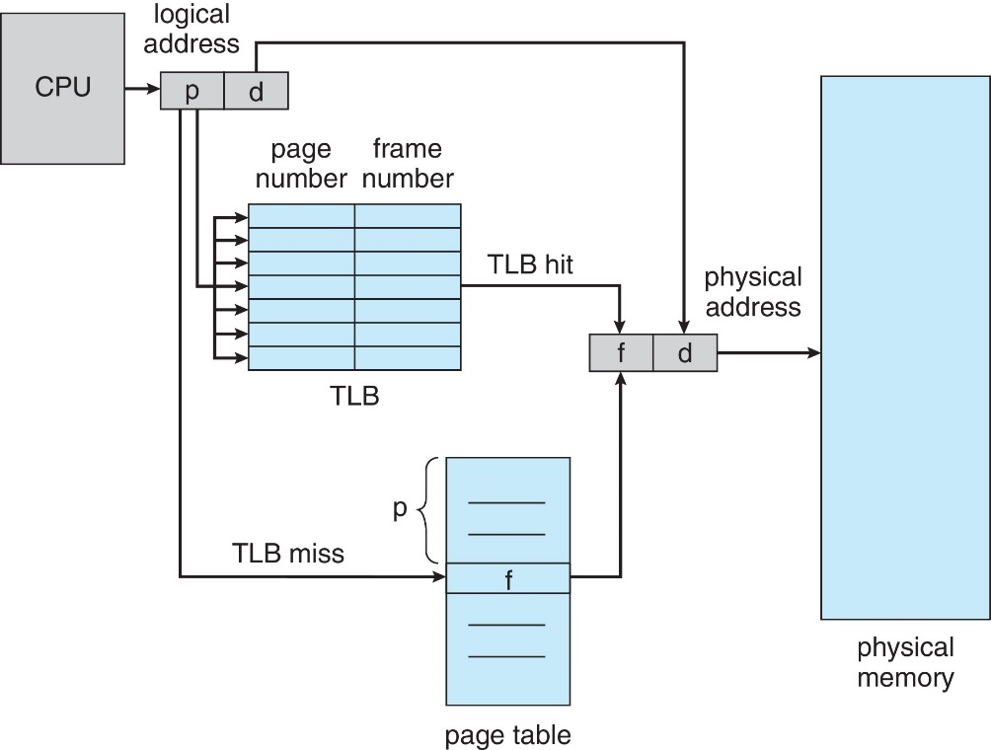
TLB is the Cache of Page Table
3
7
5
12
1
2
9
6
p_{i}
1
2
2
5
3
7
4
9
5
12
…
…..

Slide 252
Q: 如何增加TLB Reach?

Slide 253
Other Issues – TLB Reach (Cont.)
Solution:
Increase the TLB entries
TLB is expensive and power hungry
Increase the Page Size
Have the disadvantages shown previously (e.g., an increase in fragmentation)
Provide Multiple Page Sizes
Example: Solaris: a page can be 8KB, 64KB, 512KB, and 4MB
TLB reach is 512KB with 8KB pages or 256 MB with 4MB pages

Slide 254
Other Considerations
Major decisions of a paging system
Page replacement algorithm
Page allocation policy
Other considerations
Pre-paging
Page size
TLB Reach
Inverted Page Tables
Program Structure
I/O Interlock and Page Locking

Slide 255
Question: in inverted page table, how do we know the disk location of a not-in-memory pages page?
Other Issues –Inverted Page Table (Skip!)

Slide 256

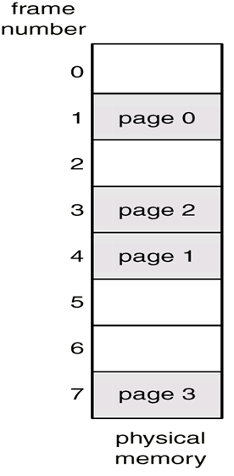

Other Issues –Inverted Page Table (Skip!)
(P1)
IPT
0
2
3
1
0
Page 3
1
2
2
2
3
1
2
Page 2
4
1
1
5
2
1
(P2)
6
2
0
7
1
3
Page 1
Question: If accessing page 5 of P1, how do we know the location of page 5 in disks?
Page 0

Slide 257
Other Issues –Inverted Page Table (Skip!)
If using IPT for address translation scheme
Problem: IPT no longer contains complete information about the logical address space of a process
No information about the not-in-memory pages!!
Which is required to handle page fault
Sol.: another table (one per process) is kept
Like page table, contains information on where each virtual page is located
But, reference only when a page fault occur

Slide 258
Other Considerations
Major decisions of a paging system
Page replacement algorithm
Page allocation policy
Other considerations
Pre-paging
Page size
TLB Reach
Inverted Page Tables
Program Structure
I/O Interlock and Page Locking

Slide 259
Other Issues – Program Structure
A[0,0]
A[0,1]
.
A[0,127]
Program structure ⇒ How to improve locality?
Example: assume only one frame
int[128,128] data; //Each row is stored in one page
Program 1 for (j=0; j<128;j++)
for (i = 0; i < 128; i++) data[i,j] = 0;
⇒ 128 x 128 = 16,384 page faults
Program 2
for (i = 0; i < 128; i++) for (j = 0; j < 128; j++) data[i,j] = 0;
⇒ 128 page faults
Page 1
A[1,0]
A[1,1]
.
A[1,127]
Page 2
A[2,0]
A[2,1]
.
A[2,127]
Page 3

Slide 260
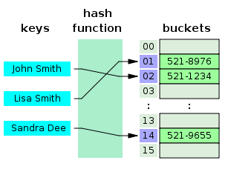
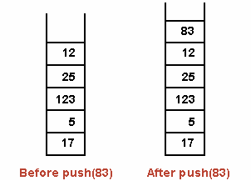
Other Issues – Program Structure (Cont.)
Data structures
Pointers, hash table: poor locality
Stack: good locality

Slide 261
Other Considerations
Major decisions of a paging system
Page replacement algorithm
Page allocation policy
Other considerations
Pre-paging
Page size
TLB Reach
Inverted Page Tables
Program Structure
I/O Interlock and Page Locking

Slide 262
Other Issues – I/O Interlock and Page Locking
A problem when doing I/O
Example
Process P₁ prepare a page as I/O buffer
Wait for the I/O to complete
Process P₂ takes the frame of P₁’s I/O page
Due to page replacement
I/O occurred to the specified address
See the next slide

Slide 263
Pending I/O Problem
page out
P₁
P₂
page in
packet
NIC

Slide 264
Q: 怎麼辦呢?

Slide 265
Other Issues – I/O Interlock and Page Locking (Cont.)
Solution 1: never execute I/O to user memory
I/O takes place only between OS memory and I/O device
Extra copies are needed for transferring data between OS memory and user memory
See the next slide
Solution 2: allow pages to be locked into memory
Page locking – pages must sometimes be locked into memory (using a lock bit)
A locked page cannot be selected for replacement

Slide 266
Solution 1:
page out
p₁
OS
p₂
page in
packet
NIC

Slide 267
Page Locking
有些OS的程式碼和資料也是被page locking
不允許被replacement algorithm選為victim而被replacement
Why?
應用程式也可以請求page locking
mlock()

